Slide 1
Definition of a Random Variable
Definitions
Definition of a Random Variable
Distribution of a Random Variable
Expectation of a Random Variable
Example Distributions
Bernoulli
Binomial
Geometric
Poisson
Lecture 18, CS70 Fall 2025

Slide 2
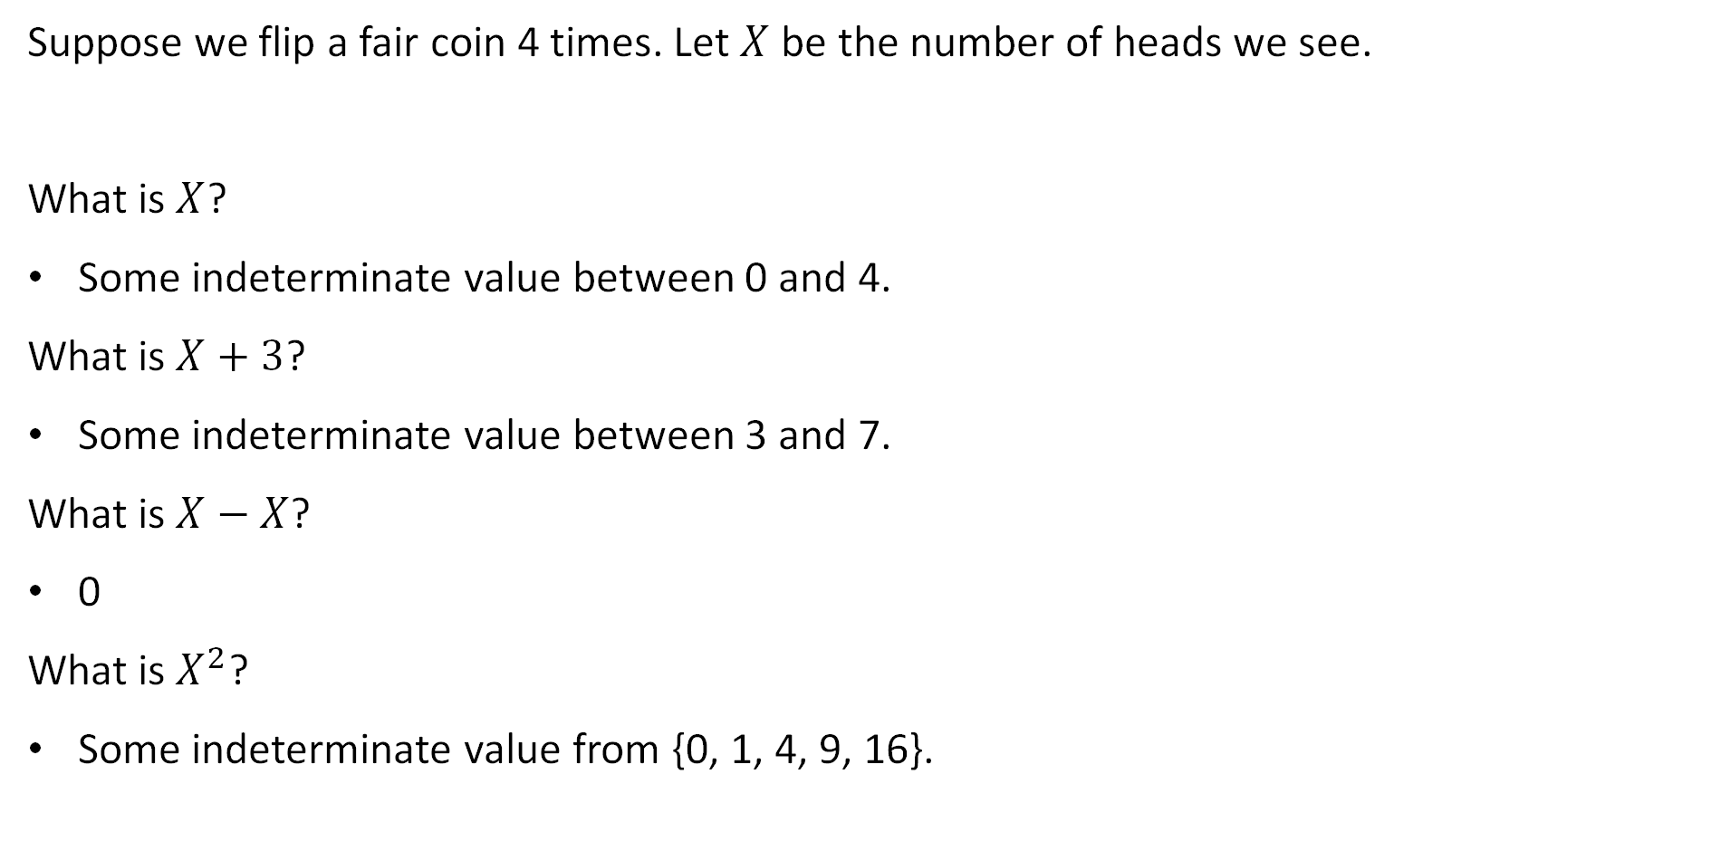
Random Variables: Informally
Suppose we flip a fair coin 4 times. Let $X$ be the number of heads we see.
What is $X$?
Some indeterminate value between 0 and 4.
What is $X+3$?
Some indeterminate value between 3 and 7.
What is $X−X$?
0
What is $X^{2}$?
Some indeterminate value from {0, 1, 4, 9, 16}.

Slide 3
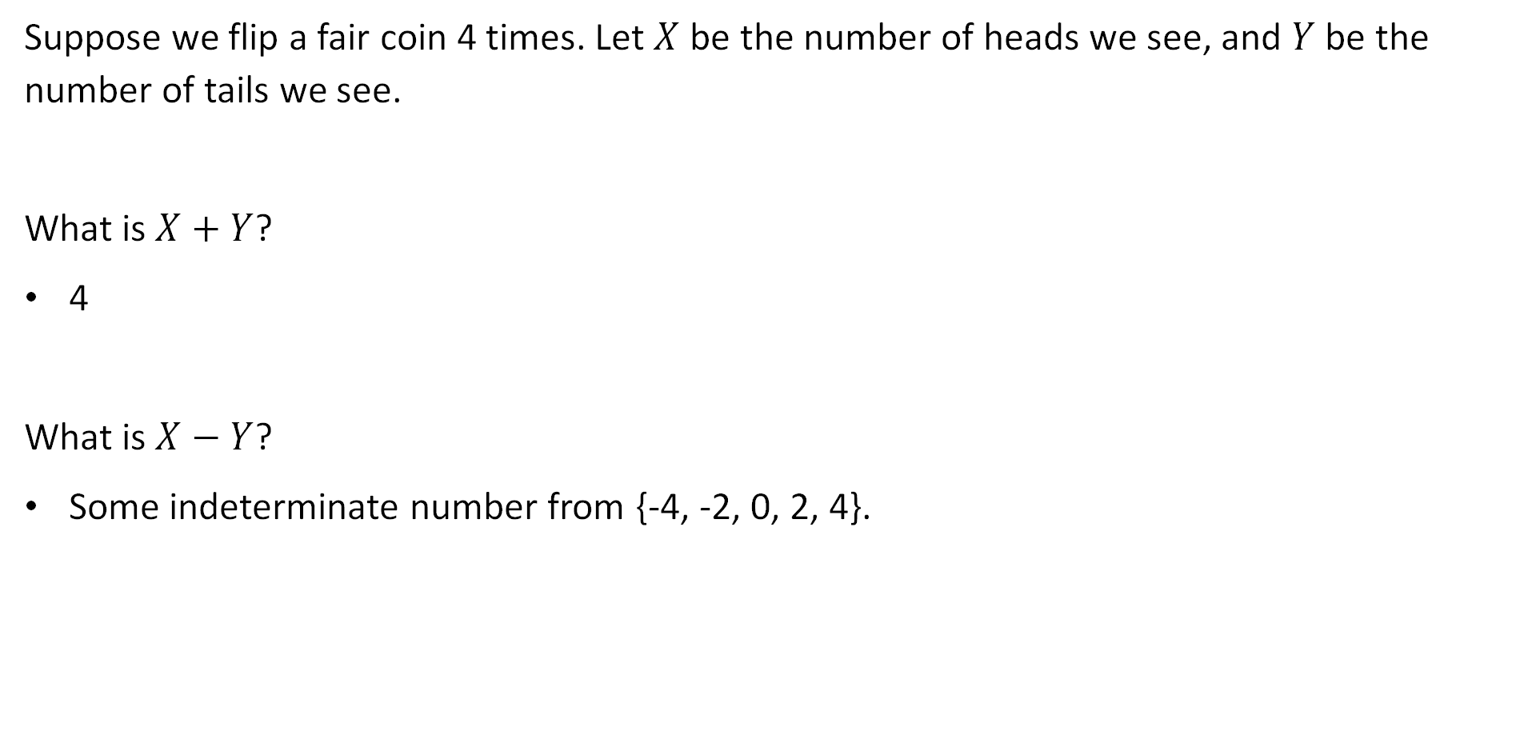
Random Variables: Informally
Suppose we flip a fair coin 4 times. Let $X$ be the number of heads we see, and $Y$ be the number of tails we see.
What is $X+Y$?
4
What is $X−Y$?
Some indeterminate number from {-4, -2, 0, 2, 4}.

Slide 4
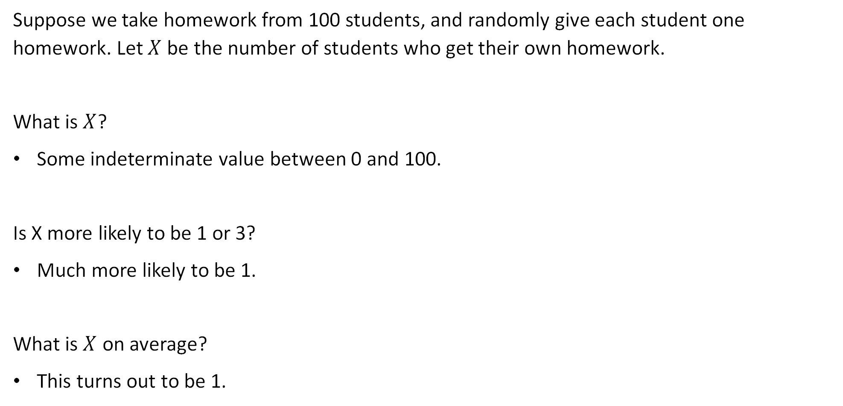
Random Variables: Informally
Suppose we take homework from 100 students, and randomly give each student one homework. Let $X$ be the number of students who get their own homework.
What is $X$?
Some indeterminate value between 0 and 100.
Is X more likely to be 1 or 3?
Much more likely to be 1.
What is $X$ on average?
This turns out to be 1.

Slide 5
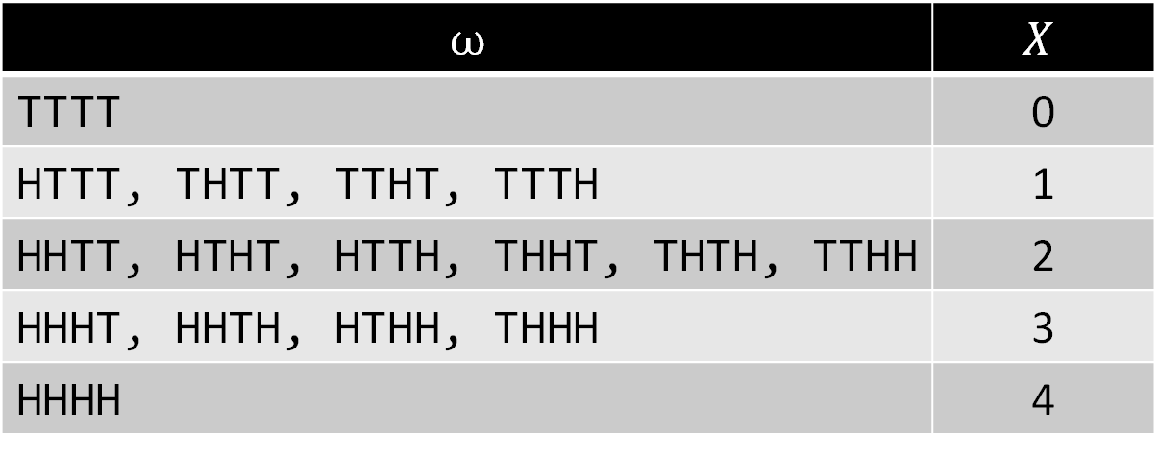
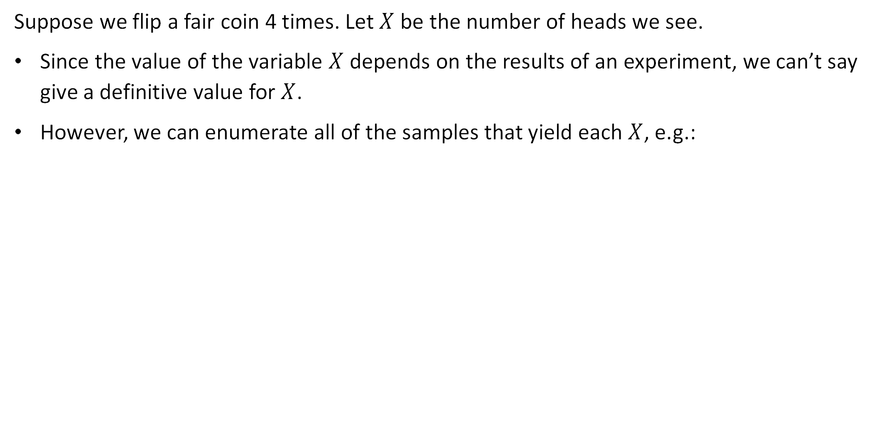
Random Variables: Informally
Suppose we flip a fair coin 4 times. Let $X$ be the number of heads we see.
Since the value of the variable $X$ depends on the results of an experiment, we can’t say give a definitive value for $X$.
However, we can enumerate all of the samples that yield each $X$, e.g.:
$$ω$$ | $$X$$
TTTT | 0
HTTT, THTT, TTHT, TTTH | 1
HHTT, HTHT, HTTH, THHT, THTH, TTHH | 2
HHHT, HHTH, HTHH, THHH | 3
HHHH | 4

Slide 6
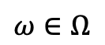
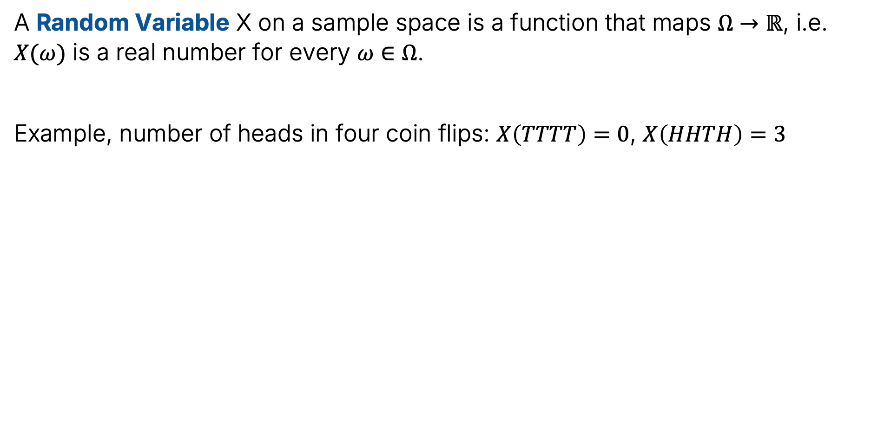
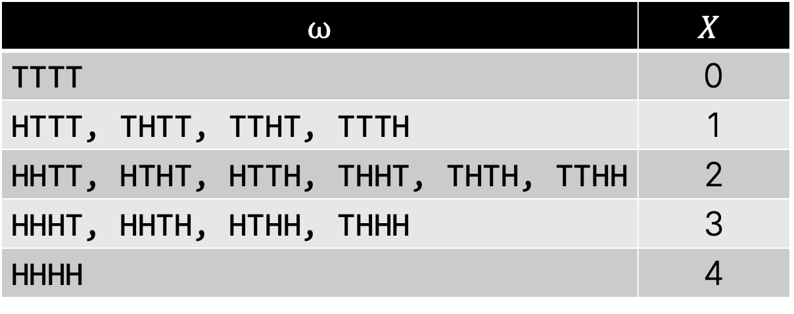
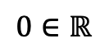
Random Variable: Formally
A Random Variable X on a sample space is a function that maps $Ω→ℝ$, i.e. $X(ω)$ is a real number for every $ω∈Ω$.
Example, number of heads in four coin flips: $X\left(TTTT\right)=0$, $X\left(HHTH\right)=3$
$$ω∈Ω$$
$$0∈ℝ$$
$$ω$$ | $$X$$
TTTT | 0
HTTT, THTT, TTHT, TTTH | 1
HHTT, HTHT, HTTH, THHT, THTH, TTHH | 2
HHHT, HHTH, HTHH, THHH | 3
HHHH | 4

Slide 7
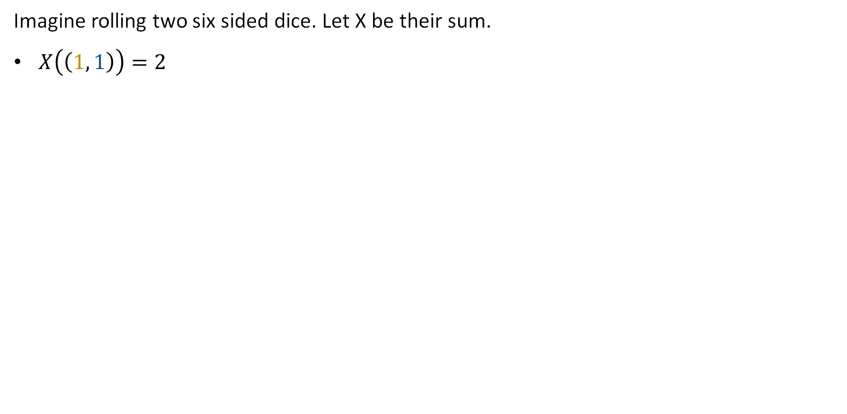
Formal Random Variable Example 2
Imagine rolling two six sided dice. Let X be their sum.
$X\left(\left(1, 1\right)\right)=2$
6
2
5
4
3
2
1
1
2
3
4
5
6

Slide 8
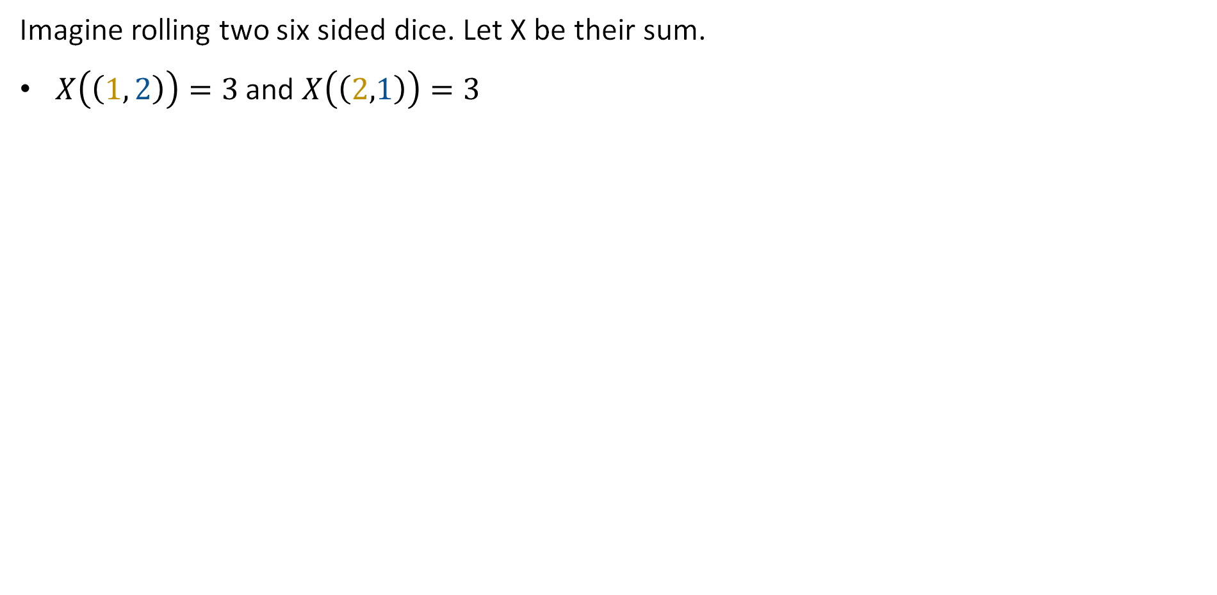
Formal Random Variable Example 2
Imagine rolling two six sided dice. Let X be their sum.
$X\left(\left(1, 2\right)\right)=3$ and $X\left(\left(2,1\right)\right)=3$
6
3
2 | 3
5
4
3
2
1
1
2
3
4
5
6

Slide 9
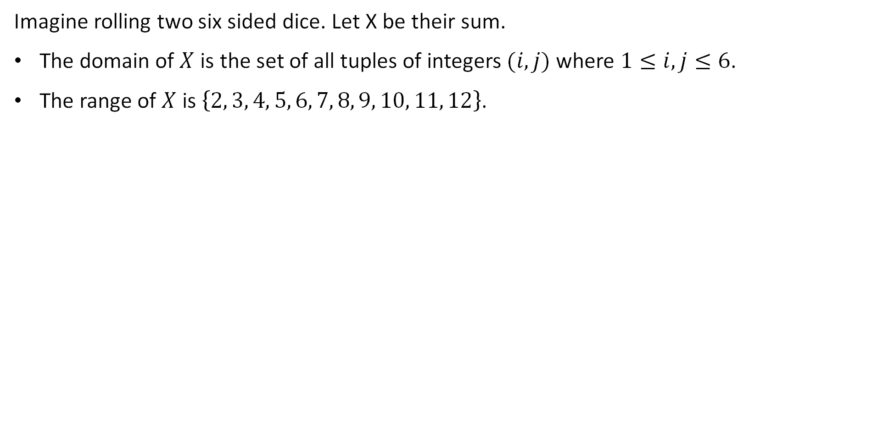
Formal Random Variable Example 2
Imagine rolling two six sided dice. Let X be their sum.
The domain of $X$ is the set of all tuples of integers $(i, j)$ where $1≤i,j≤6$.
The range of $X$ is $\left\{2, 3, 4, 5, 6, 7, 8, 9, 10, 11, 12\right\}$.
6
7 | 8 | 9 | 10 | 11 | 12
6 | 7 | 8 | 9 | 10 | 11
5 | 6 | 7 | 8 | 9 | 10
4 | 5 | 6 | 7 | 8 | 9
3 | 4 | 5 | 6 | 7 | 8
2 | 3 | 4 | 5 | 6 | 7
5
$X\left(\left(4,6\right)\right)=10$
4
3
2
1
1
2
3
4
5
6

Slide 10
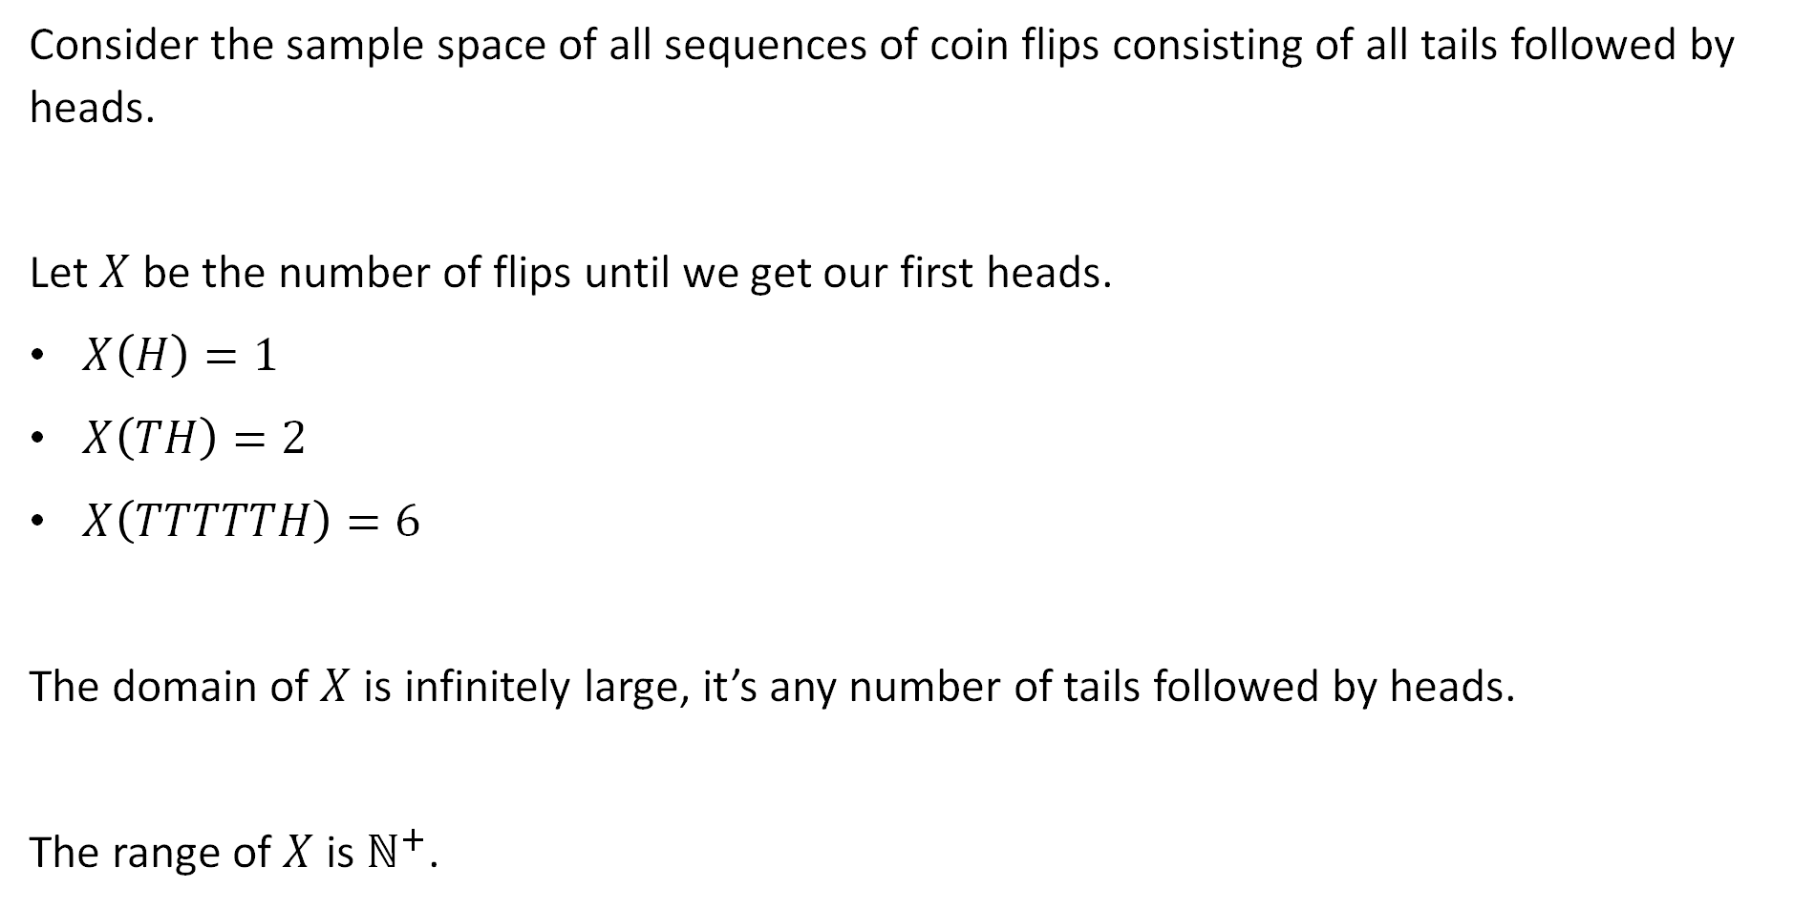
Formal Random Variable Example 3
Consider the sample space of all sequences of coin flips consisting of all tails followed by heads.
Let $X$ be the number of flips until we get our first heads.
$X\left(H\right)=1$
$X\left(TH\right)=2$
$X\left(TTTTTH\right)=6$
The domain of $X$ is infinitely large, it’s any number of tails followed by heads.
The range of $X$ is $ℕ^{+}$.

Slide 11
Distribution of a Random Variable
Definitions
Definition of a Random Variable
Distribution of a Random Variable
Expectation of a Random Variable
Example Distributions
Bernoulli
Binomial
Geometric
Poisson
Lecture 18, CS70 Fall 2025

Slide 12
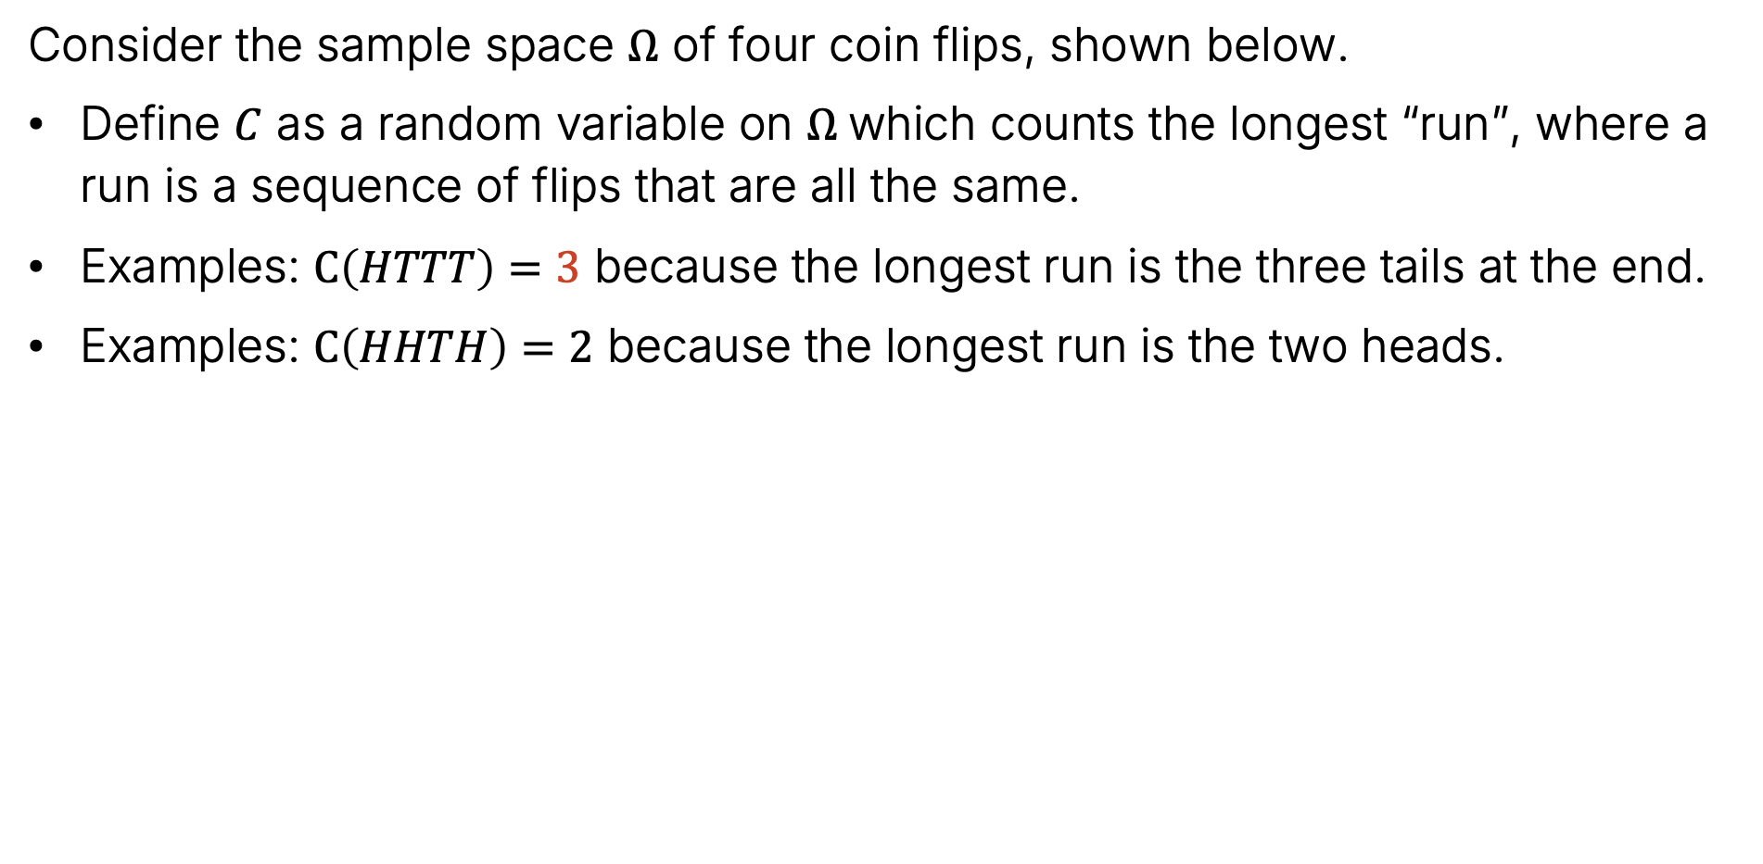
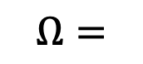
Events and Probability Spaces
Consider the sample space $Ω$ of four coin flips, shown below.
Define $C$ as a random variable on $Ω$which counts the longest “run”, where a run is a sequence of flips that are all the same.
Examples: $C\left(HTTT\right)=3$ because the longest run is the three tails at the end.
Examples: $C\left(HHTH\right)=2$ because the longest run is the two heads.
3
HHHH HHHT HHTH HHTT
HTHH HTHT HTTH HTTT
THHH THHT THTH THTT
TTHH TTHT TTTH TTTT
$$Ω=$$

Slide 13
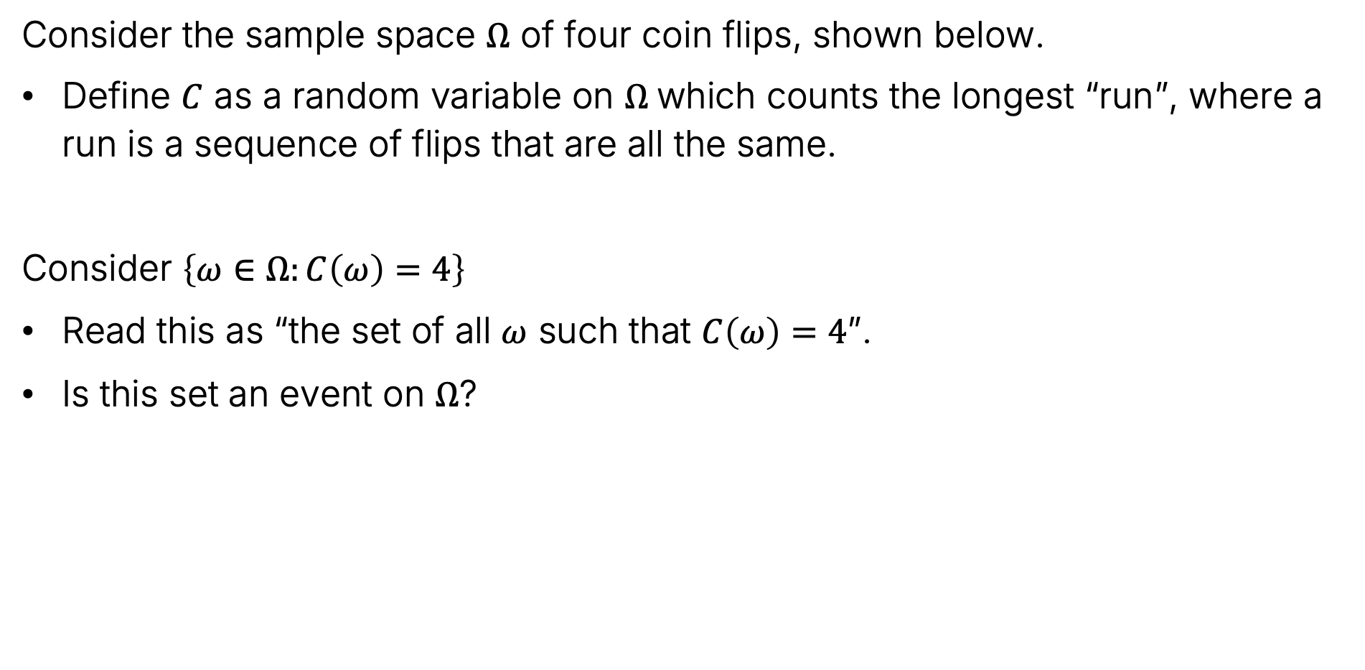
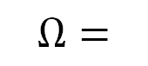
Events and Probability Spaces
Consider the sample space $Ω$ of four coin flips, shown below.
Define $C$ as a random variable on $Ω$which counts the longest “run”, where a run is a sequence of flips that are all the same.
Consider $\left\{ω∈Ω:C\left(ω\right)=4\right\}$
Read this as “the set of all $ω$ such that $C\left(ω\right)=4$”.
Is this set an event on $Ω$?
HHHH HHHT HHTH HHTT
HTHH HTHT HTTH HTTT
THHH THHT THTH THTT
TTHH TTHT TTTH TTTT
$$Ω=$$

Slide 14
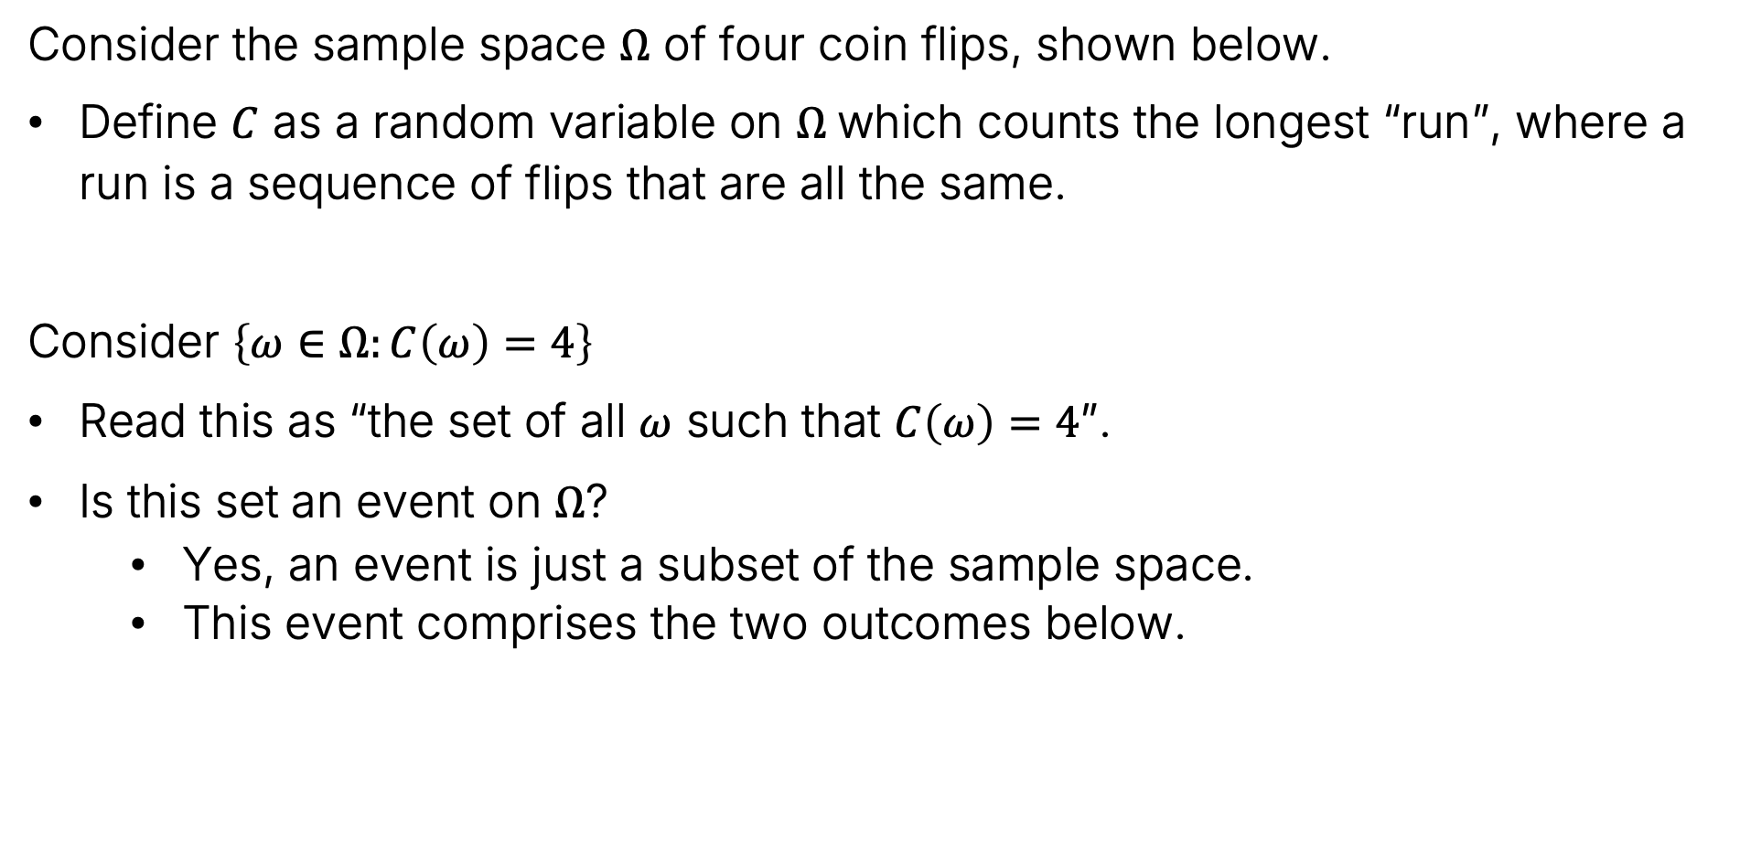
Events and Probability Spaces
Consider the sample space $Ω$ of four coin flips, shown below.
Define $C$ as a random variable on $Ω$which counts the longest “run”, where a run is a sequence of flips that are all the same.
Consider $\left\{ω∈Ω:C\left(ω\right)=4\right\}$
Read this as “the set of all $ω$ such that $C\left(ω\right)=4$”.
Is this set an event on $Ω$?
Yes, an event is just a subset of the sample space.
This event comprises the two outcomes below.
HHHH HHHT HHTH HHTT
HTHH HTHT HTTH HTTT
THHH THHT THTH THTT
TTHH TTHT TTTH TTTT
$$Ω=$$

Slide 15
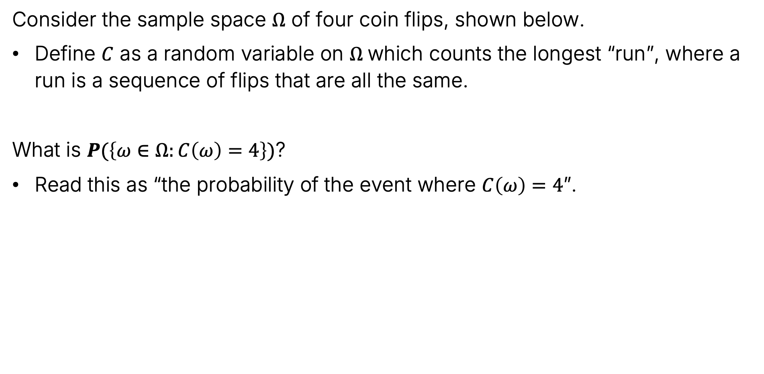
Events and Probability Spaces
Consider the sample space $Ω$ of four coin flips, shown below.
Define $C$ as a random variable on $Ω$which counts the longest “run”, where a run is a sequence of flips that are all the same.
What is $P(\left\{ω∈Ω:C\left(ω\right)=4\right\})$?
Read this as “the probability of the event where $C\left(ω\right)=4$”.
HHHH HHHT HHTH HHTT
HTHH HTHT HTTH HTTT
THHH THHT THTH THTT
TTHH TTHT TTTH TTTT
$$Ω=$$

Slide 16
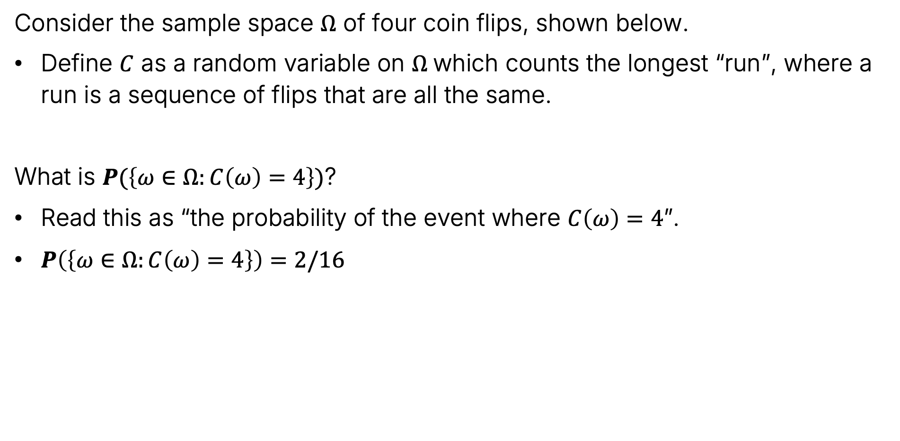
Events and Probability Spaces
Consider the sample space $Ω$ of four coin flips, shown below.
Define $C$ as a random variable on $Ω$which counts the longest “run”, where a run is a sequence of flips that are all the same.
What is $P(\left\{ω∈Ω:C\left(ω\right)=4\right\})$?
Read this as “the probability of the event where $C\left(ω\right)=4$”.
$P\left(\left\{ω∈Ω:C\left(ω\right)=4\right\}\right)=2/16$
HHHH HHHT HHTH HHTT
HTHH HTHT HTTH HTTT
THHH THHT THTH THTT
TTHH TTHT TTTH TTTT
$$Ω=$$

Slide 17
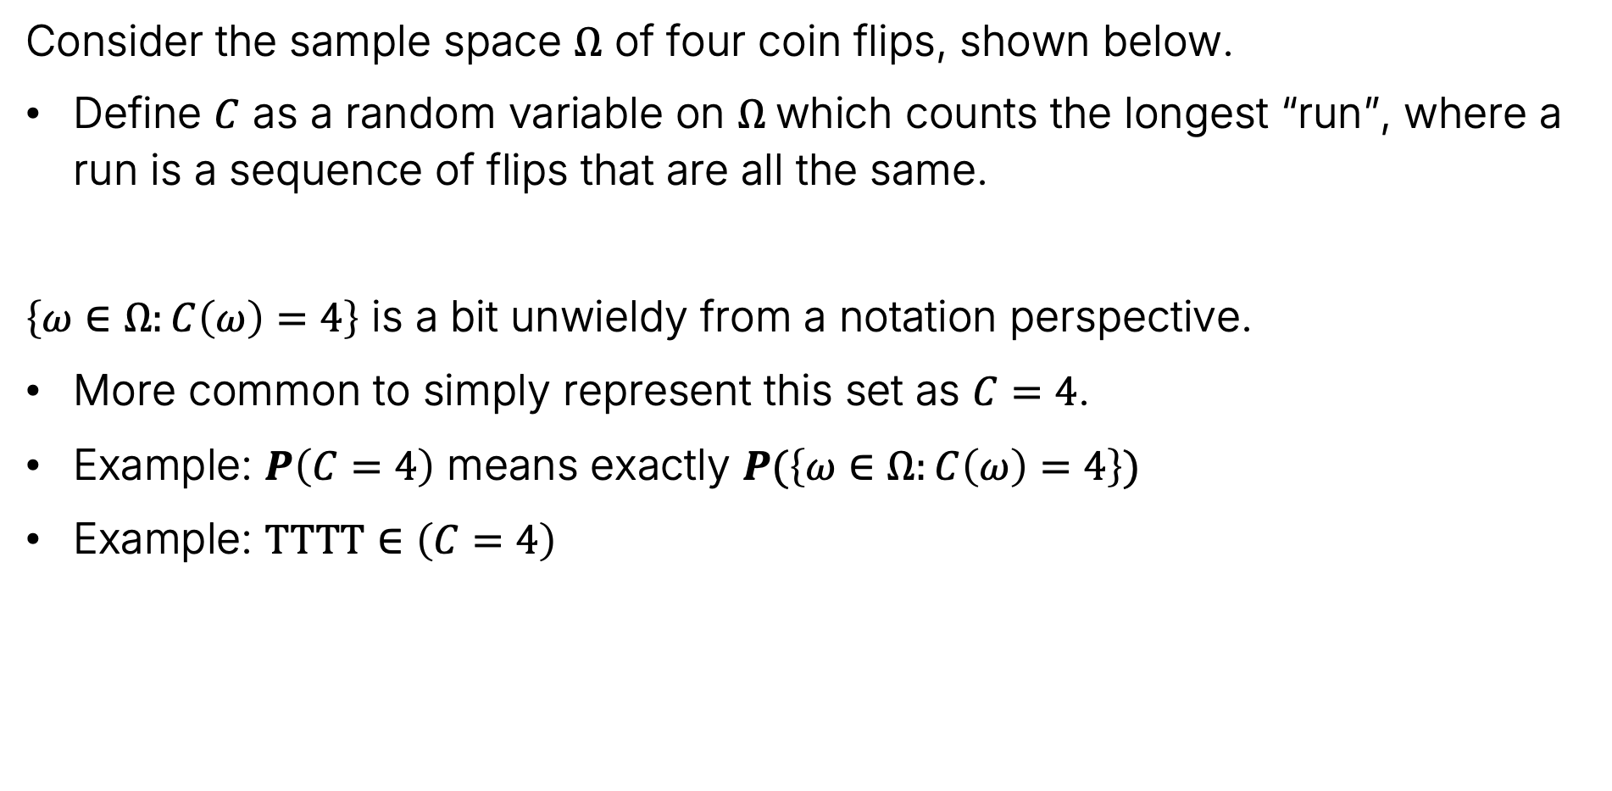
Events and Probability Spaces
Consider the sample space $Ω$ of four coin flips, shown below.
Define $C$ as a random variable on $Ω$which counts the longest “run”, where a run is a sequence of flips that are all the same.
$\left\{ω∈Ω:C\left(ω\right)=4\right\}$ is a bit unwieldy from a notation perspective.
More common to simply represent this set as $C=4$.
Example: $P\left(C=4\right)$ means exactly $P(\left\{ω∈Ω:C\left(ω\right)=4\right\})$
Example: $TTTT∈\left(C=4\right)$
HHHH HHHT HHTH HHTT
HTHH HTHT HTTH HTTT
THHH THHT THTH THTT
TTHH TTHT TTTH TTTT
$$Ω=$$

Slide 18
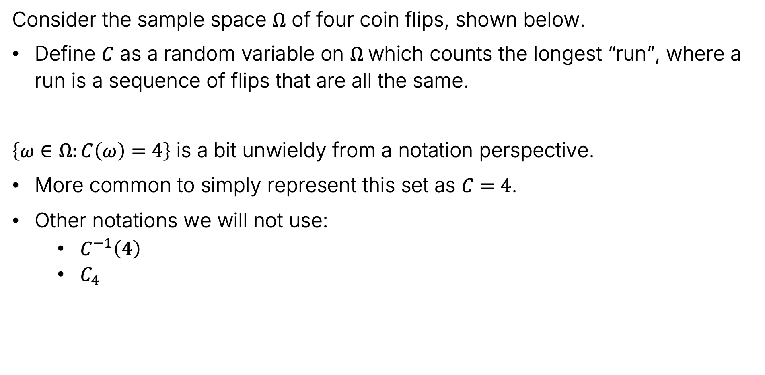
Events and Probability Spaces
Consider the sample space $Ω$ of four coin flips, shown below.
Define $C$ as a random variable on $Ω$which counts the longest “run”, where a run is a sequence of flips that are all the same.
$\left\{ω∈Ω:C\left(ω\right)=4\right\}$ is a bit unwieldy from a notation perspective.
More common to simply represent this set as $C=4$.
Other notations we will not use:
$C^{−1}\left(4\right)$
$C_{4}$
HHHH HHHT HHTH HHTT
HTHH HTHT HTTH HTTT
THHH THHT THTH THTT
TTHH TTHT TTTH TTTT
$$Ω=$$

Slide 19

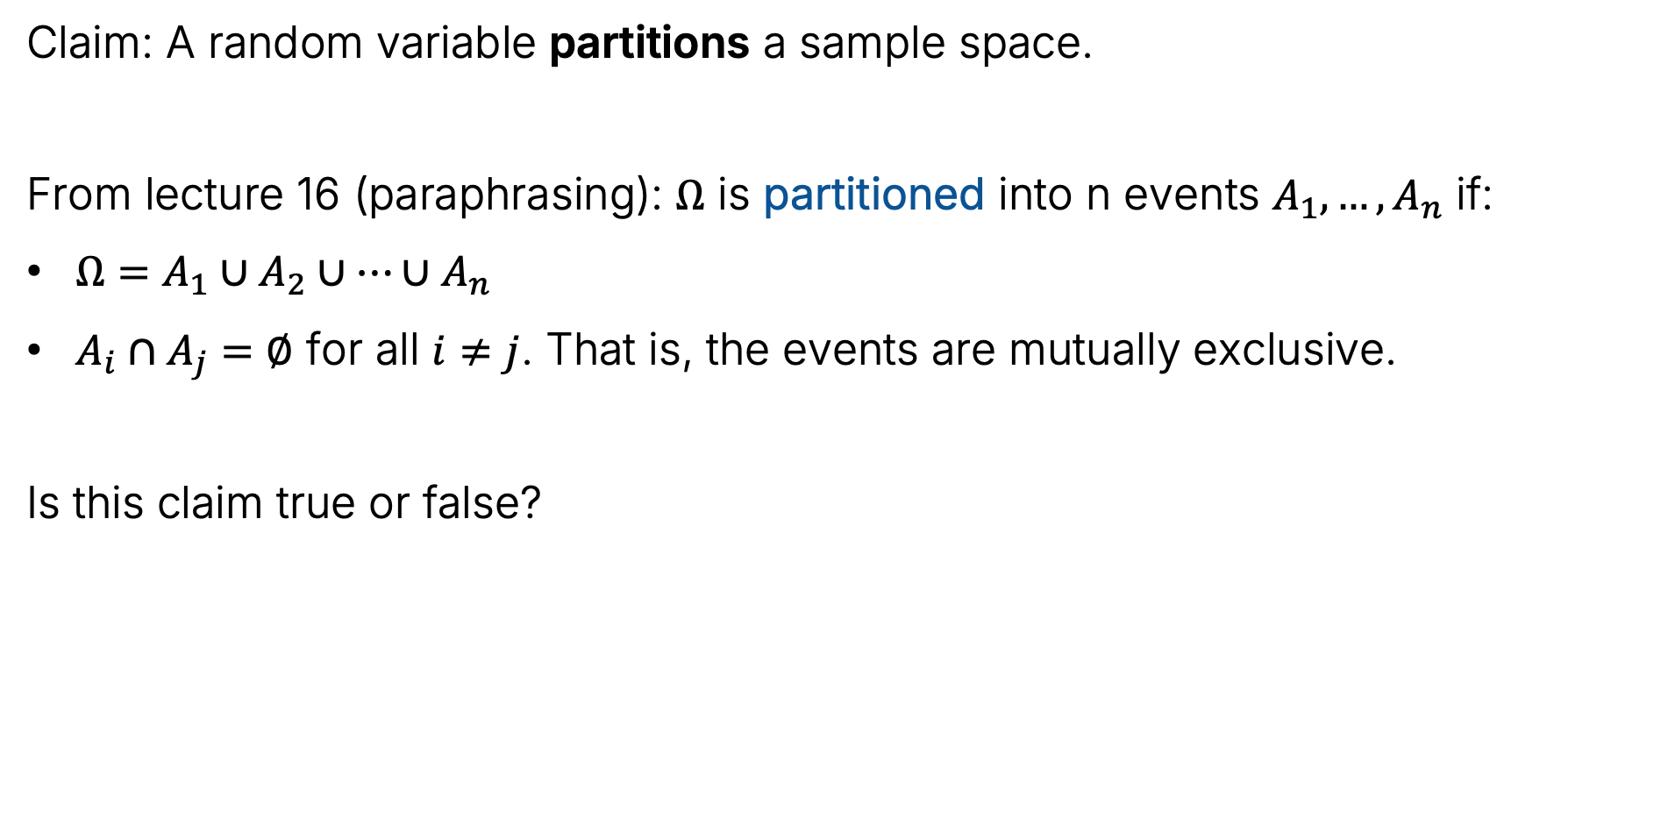
Events and Random Variables
Claim: A random variable partitions a sample space.
From lecture 16 (paraphrasing): $Ω$ is partitioned into n events $A_{1},…,A_{n}$ if:
$Ω=A_{1}∪A_{2}∪…∪A_{n}$
$A_{i}∩A_{j}=∅$ for all $i≠j$. That is, the events are mutually exclusive.
Is this claim true or false?
https://joshh.ug/A

Slide 20
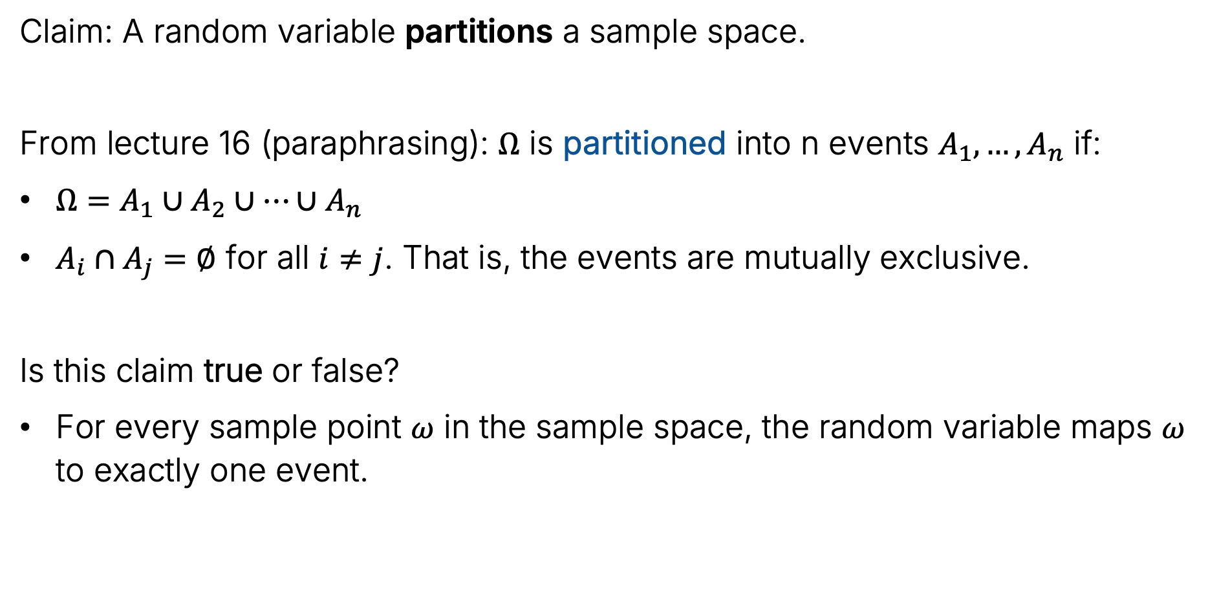
Events and Random Variables
Claim: A random variable partitions a sample space.
From lecture 16 (paraphrasing): $Ω$ is partitioned into n events $A_{1},…,A_{n}$ if:
$Ω=A_{1}∪A_{2}∪…∪A_{n}$
$A_{i}∩A_{j}=∅$ for all $i≠j$. That is, the events are mutually exclusive.
Is this claim true or false?
For every sample point $ω$ in the sample space, the random variable maps $ω$ to exactly one event.

Slide 21
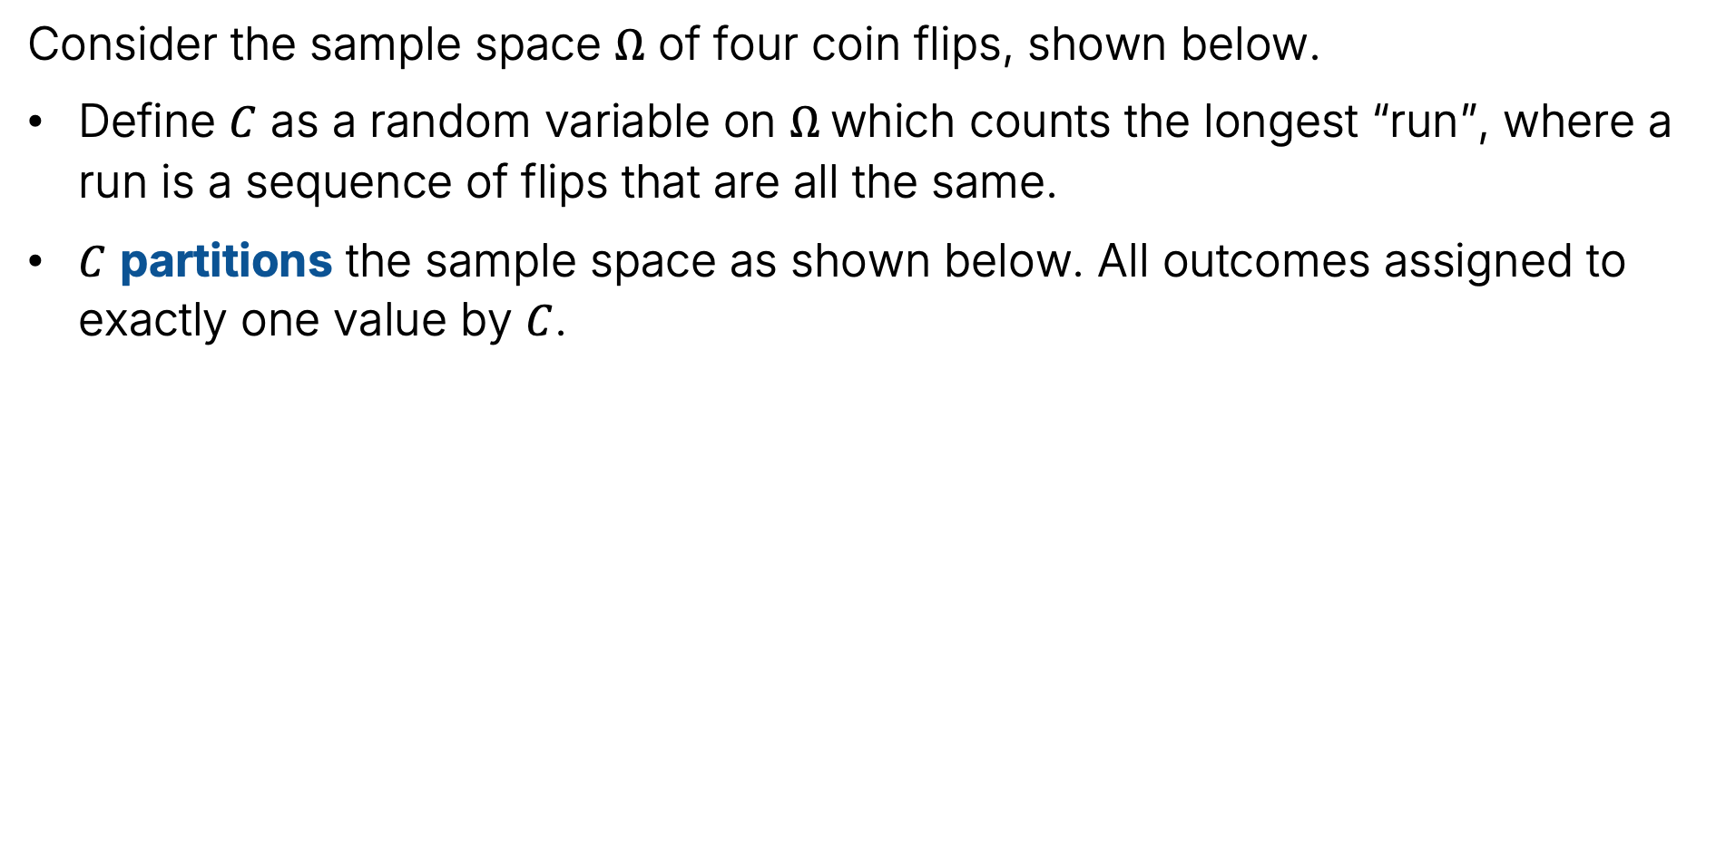
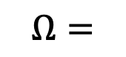
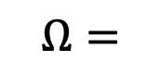
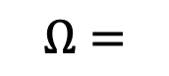
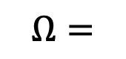
Example: $C$ Partitions Coin Flips
Consider the sample space $Ω$ of four coin flips, shown below.
Define $C$ as a random variable on $Ω$which counts the longest “run”, where a run is a sequence of flips that are all the same.
$C$ partitions the sample space as shown below. All outcomes assigned to exactly one value by $C$.
HHHH HHHT HHTH HHTT
HTHH HTHT HTTH HTTT
THHH THHT THTH THTT
TTHH TTHT TTTH TTTT
HHHH HHHT HHTH HHTT
HTHH HTHT HTTH HTTT
THHH THHT THTH THTT
TTHH TTHT TTTH TTTT
$$Ω=$$
$$Ω=$$
HHHH HHHT HHTH HHTT
HTHH HTHT HTTH HTTT
THHH THHT THTH THTT
TTHH TTHT TTTH TTTT
HHHH HHHT HHTH HHTT
HTHH HTHT HTTH HTTT
THHH THHT THTH THTT
TTHH TTHT TTTH TTTT
$$Ω=$$
$$Ω=$$

Slide 22
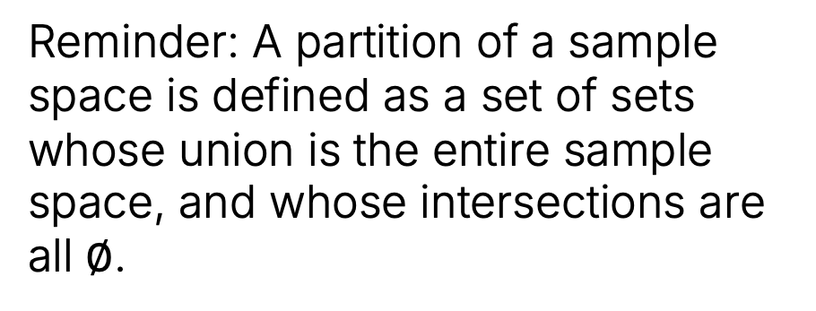
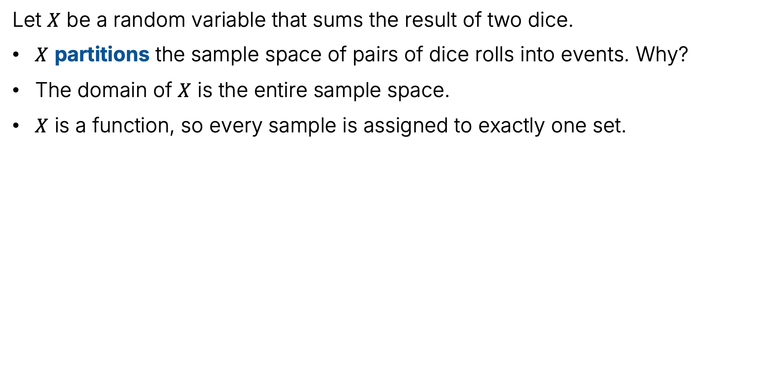
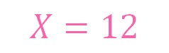

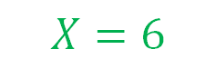
Another Example: Pairs of Dice
Let $X$ be a random variable that sums the result of two dice.
$X$ partitions the sample space of pairs of dice rolls into events. Why?
The domain of $X$ is the entire sample space.
$X$ is a function, so every sample is assigned to exactly one set.
6
7 | 8 | 9 | 10 | 11 | 12
6 | 7 | 8 | 9 | 10 | 11
5 | 6 | 7 | 8 | 9 | 10
4 | 5 | 6 | 7 | 8 | 9
3 | 4 | 5 | 6 | 7 | 8
2 | 3 | 4 | 5 | 6 | 7
$$X=12$$
5
4
3
$$X=9$$
Reminder: A partition of a sample space is defined as a set of sets whose union is the entire sample space, and whose intersections are all $∅$.
2
1
1
2
3
4
5
6
$$X=6$$

Slide 23
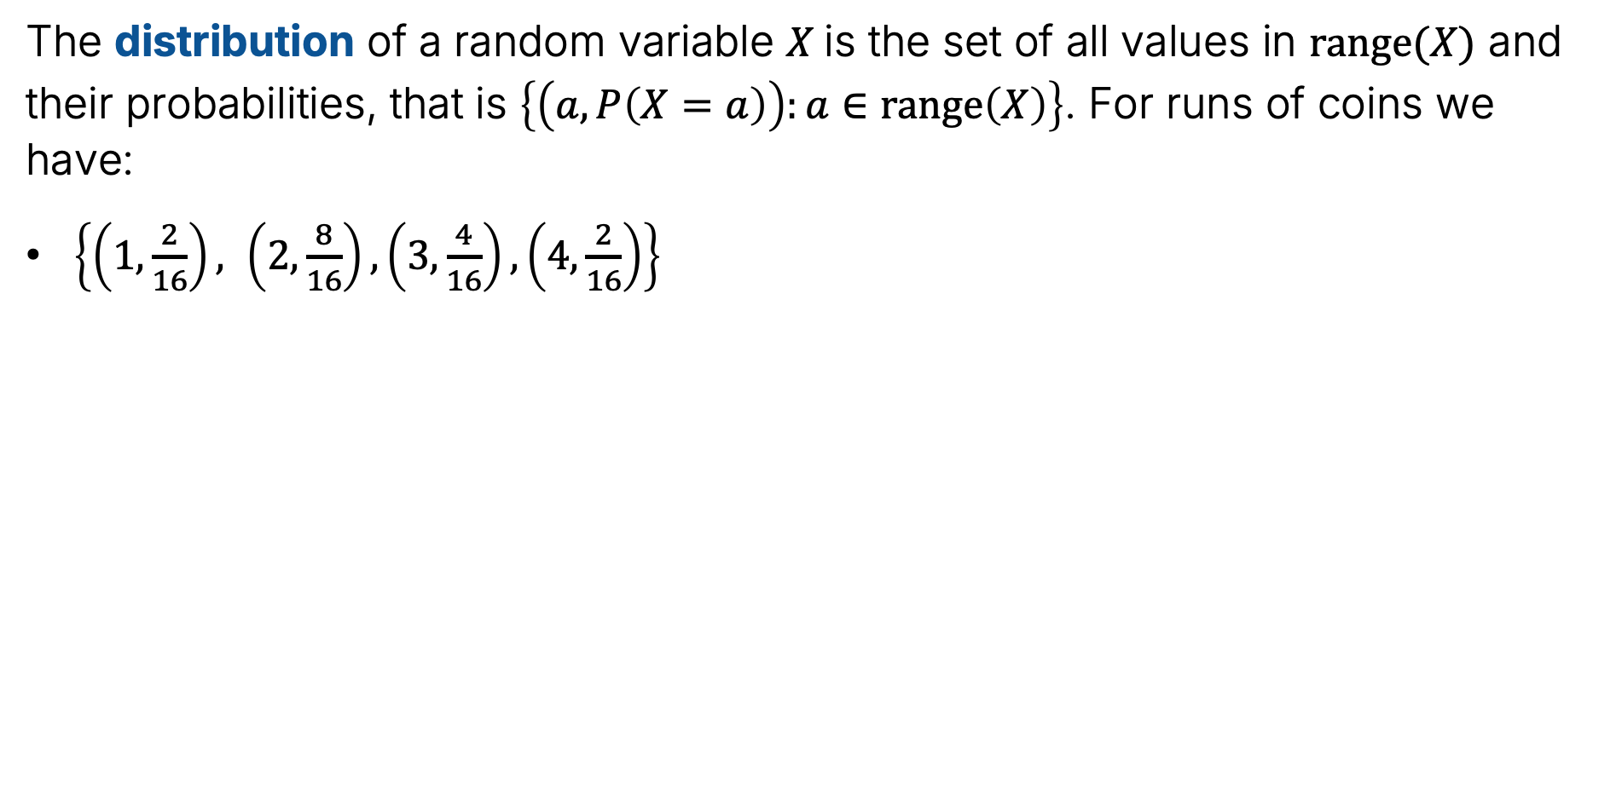
The Distribution of a Random Variable
The distribution of a random variable $X$is the set of all values in $range(X)$ and their probabilities, that is $\left\{\left(a,P\left(X=a\right)\right):a∈range\left(X\right)\right\}$. For runs of coins we have:
$\left\{\left(1,\frac{2}{16}\right), \left(2,\frac{8}{16}\right),\left(3,\frac{4}{16}\right),\left(4,\frac{2}{16}\right)\right\}$
HHHH HHHT HHTH HHTT
HTHH HTHT HTTH HTTT
THHH THHT THTH THTT
TTHH TTHT TTTH TTTT
HHHH HHHT HHTH HHTT
HTHH HTHT HTTH HTTT
THHH THHT THTH THTT
TTHH TTHT TTTH TTTT
$$Ω=$$
$$Ω=$$
HHHH HHHT HHTH HHTT
HTHH HTHT HTTH HTTT
THHH THHT THTH THTT
TTHH TTHT TTTH TTTT
HHHH HHHT HHTH HHTT
HTHH HTHT HTTH HTTT
THHH THHT THTH THTT
TTHH TTHT TTTH TTTT
$$Ω=$$
$$Ω=$$

Slide 24
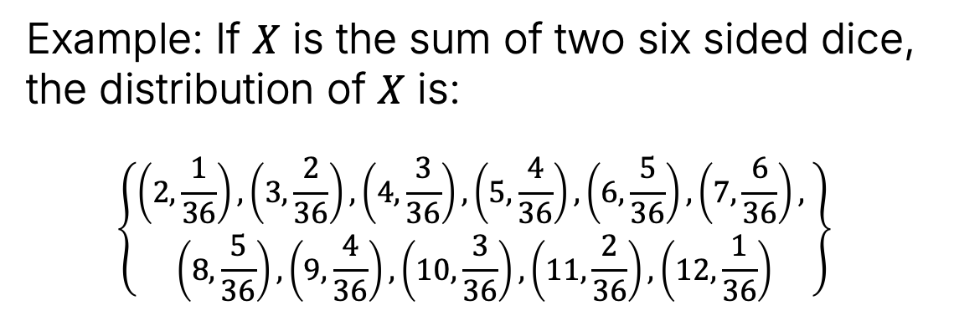
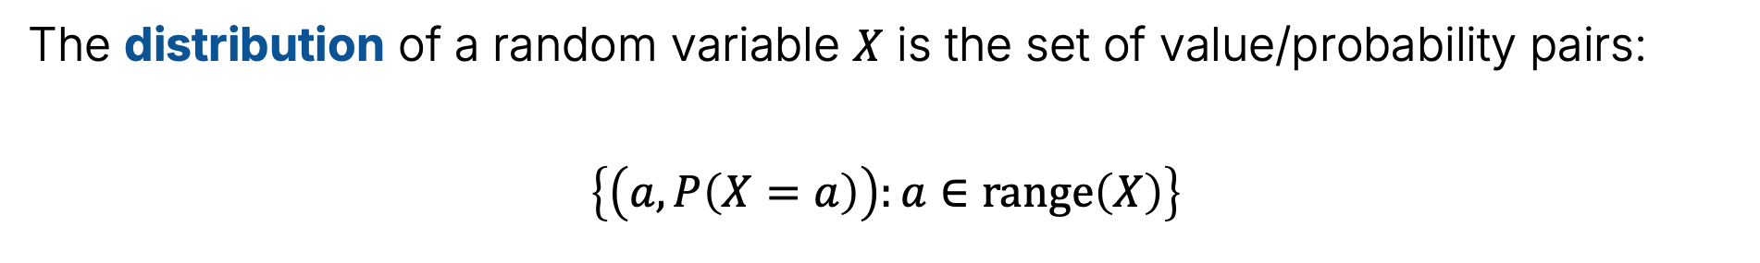
Distribution of a Random Variable
The distribution of a random variable $X$ is the set of value/probability pairs:
$$\left\{\left(a,P\left(X=a\right)\right):a∈range\left(X\right)\right\}$$
7 | 8 | 9 | 10 | 11 | 12
6 | 7 | 8 | 9 | 10 | 11
5 | 6 | 7 | 8 | 9 | 10
4 | 5 | 6 | 7 | 8 | 9
3 | 4 | 5 | 6 | 7 | 8
2 | 3 | 4 | 5 | 6 | 7
Example: If $X$ is the sum of two six sided dice, the distribution of $X$ is:
$$\left\{\begin{aligned}\left(2,\frac{1}{36}\right), \left(3,\frac{2}{36}\right),\left(4,\frac{3}{36}\right),\left(5,\frac{4}{36}\right),\left(6,\frac{5}{36}\right), \left(7,\frac{6}{36}\right), \\ \left(8,\frac{5}{36}\right), \left(9,\frac{4}{36}\right), \left(10,\frac{3}{36}\right), \left(11,\frac{2}{36}\right), \left(12,\frac{1}{36}\right)\end{aligned}\right\}$$
6
5
4
3
2
1
1
2
3
4
5
6

Slide 25
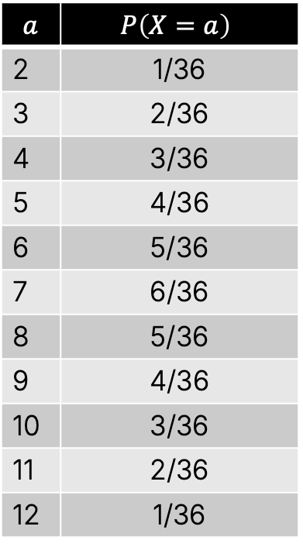
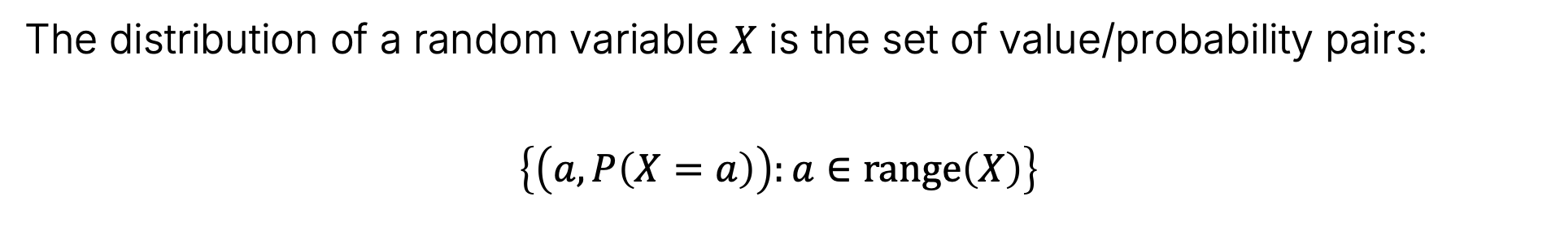
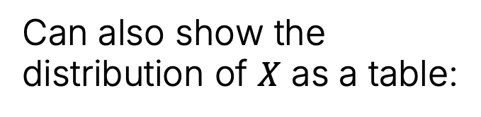
Distribution of a Random Variable
The distribution of a random variable $X$ is the set of value/probability pairs:
$$\left\{\left(a,P\left(X=a\right)\right):a∈range\left(X\right)\right\}$$
7 | 8 | 9 | 10 | 11 | 12
6 | 7 | 8 | 9 | 10 | 11
5 | 6 | 7 | 8 | 9 | 10
4 | 5 | 6 | 7 | 8 | 9
3 | 4 | 5 | 6 | 7 | 8
2 | 3 | 4 | 5 | 6 | 7
Can also show the distribution of $X$ as a table:
$$a$$ | $$P\left(X=a\right)$$
2 | 1/36
3 | 2/36
4 | 3/36
5 | 4/36
6 | 5/36
7 | 6/36
8 | 5/36
9 | 4/36
10 | 3/36
11 | 2/36
12 | 1/36
6
5
4
3
2
1
1
2
3
4
5
6

Slide 26
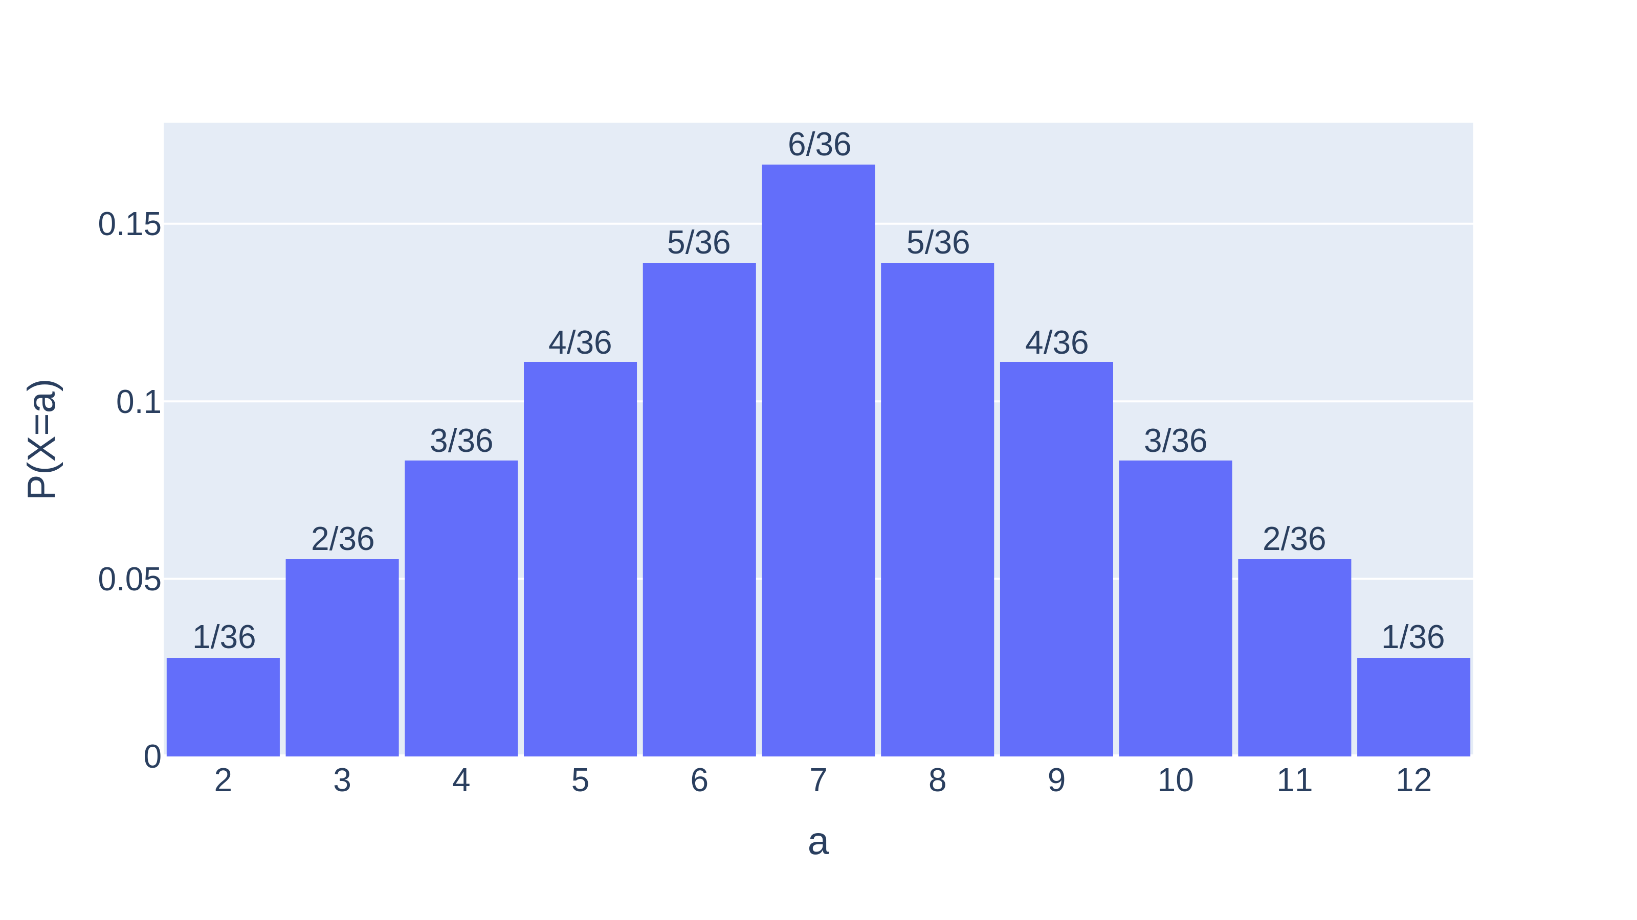
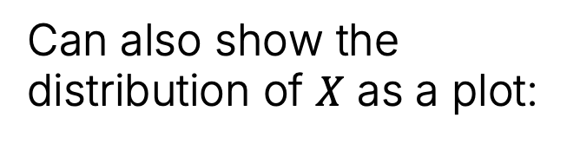
Distribution of a Random Variable
The distribution of a random variable $X$ is the set of value/probability pairs:
$$\left\{\left(a,P\left(X=a\right)\right):a∈range\left(X\right)\right\}$$
Can also show the distribution of $X$ as a plot:
6
7 | 8 | 9 | 10 | 11 | 12
6 | 7 | 8 | 9 | 10 | 11
5 | 6 | 7 | 8 | 9 | 10
4 | 5 | 6 | 7 | 8 | 9
3 | 4 | 5 | 6 | 7 | 8
2 | 3 | 4 | 5 | 6 | 7
5
4
3
2
1
1
2
3
4
5
6

Slide 27
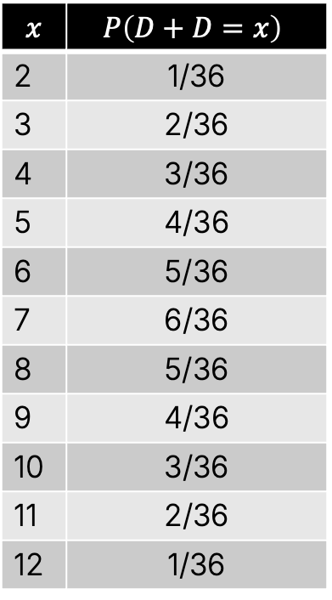
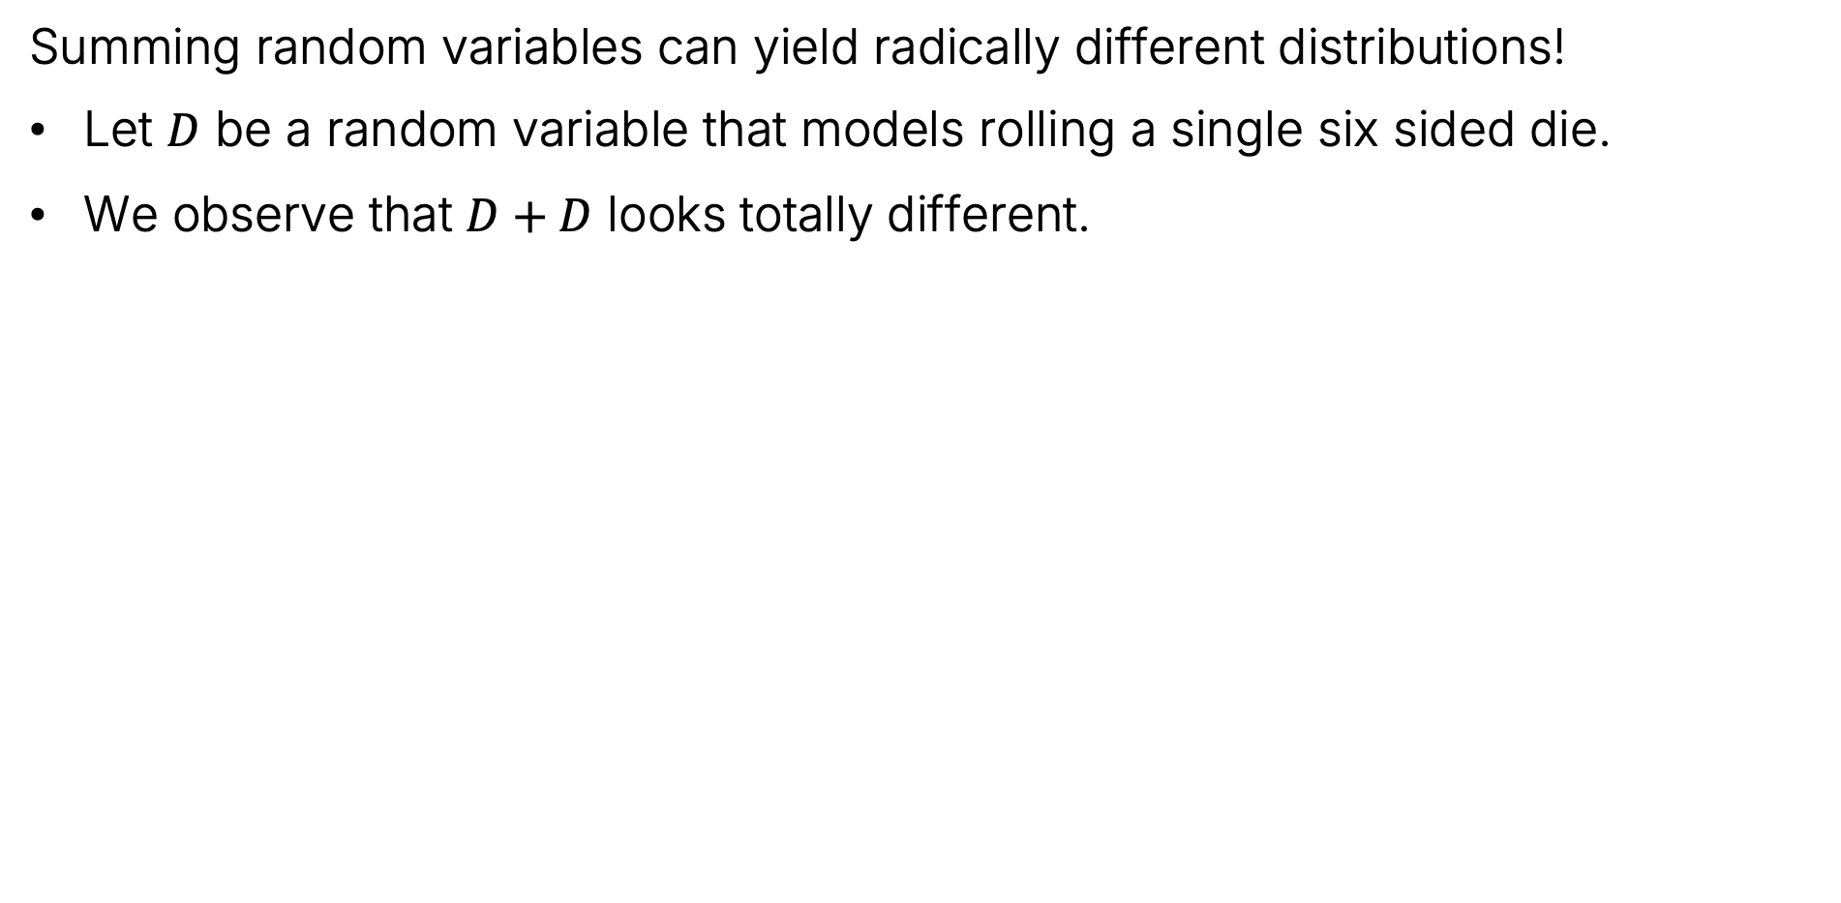
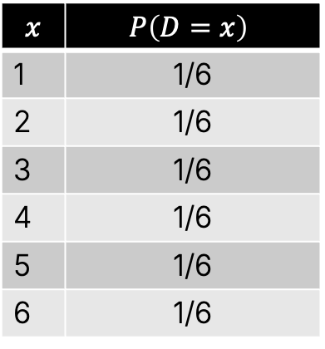
Note
Summing random variables can yield radically different distributions!
Let $D$ be a random variable that models rolling a single six sided die.
We observe that $D+D$ looks totally different.
$$x$$ | $$P\left(D=x\right)$$
1 | 1/6
2 | 1/6
3 | 1/6
4 | 1/6
5 | 1/6
6 | 1/6
$$x$$ | $$P\left(D+D=x\right)$$
2 | 1/36
3 | 2/36
4 | 3/36
5 | 4/36
6 | 5/36
7 | 6/36
8 | 5/36
9 | 4/36
10 | 3/36
11 | 2/36
12 | 1/36

Slide 28
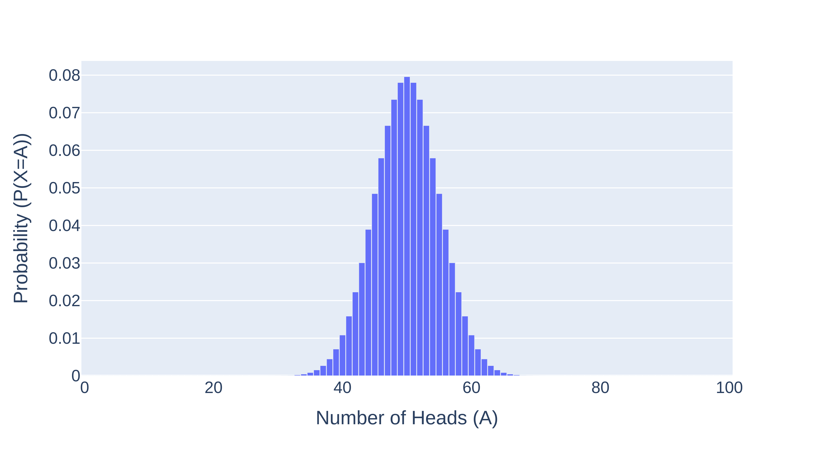
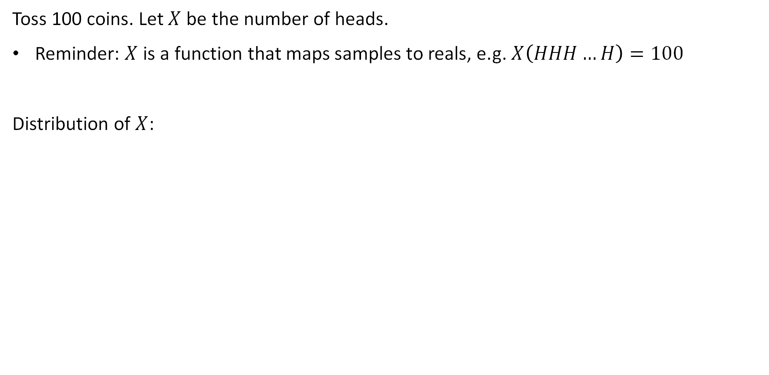

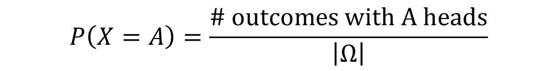
Distribution Example 2: Tossing 100 Coins
Toss 100 coins. Let $X$ be the number of heads.
Reminder: $X$ is a function that maps samples to reals, e.g. $X\left(HHH…H\right)=100$
Distribution of $X$:
$$=\frac{\left({100 \atop A}\right)}{2^{100}}$$
$$P\left(X=A\right)=\frac{\# outcomes with A heads}{\left|Ω\right|}$$

Slide 29

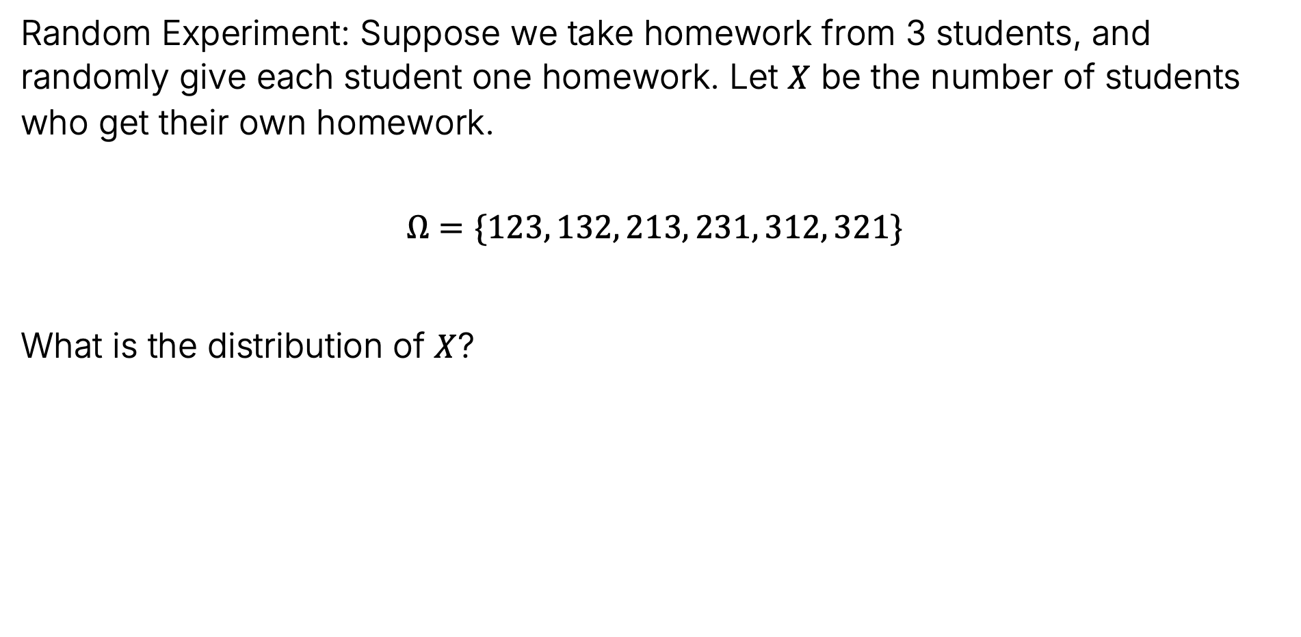
Distribution Example 3: Handing Back Assignments
Random Experiment: Suppose we take homework from 3 students, and randomly give each student one homework. Let $X$ be the number of students who get their own homework.
$$Ω=\{123, 132, 213, 231, 312, 321\}$$
What is the distribution of $X$?
Joshh.ug/b

Slide 30
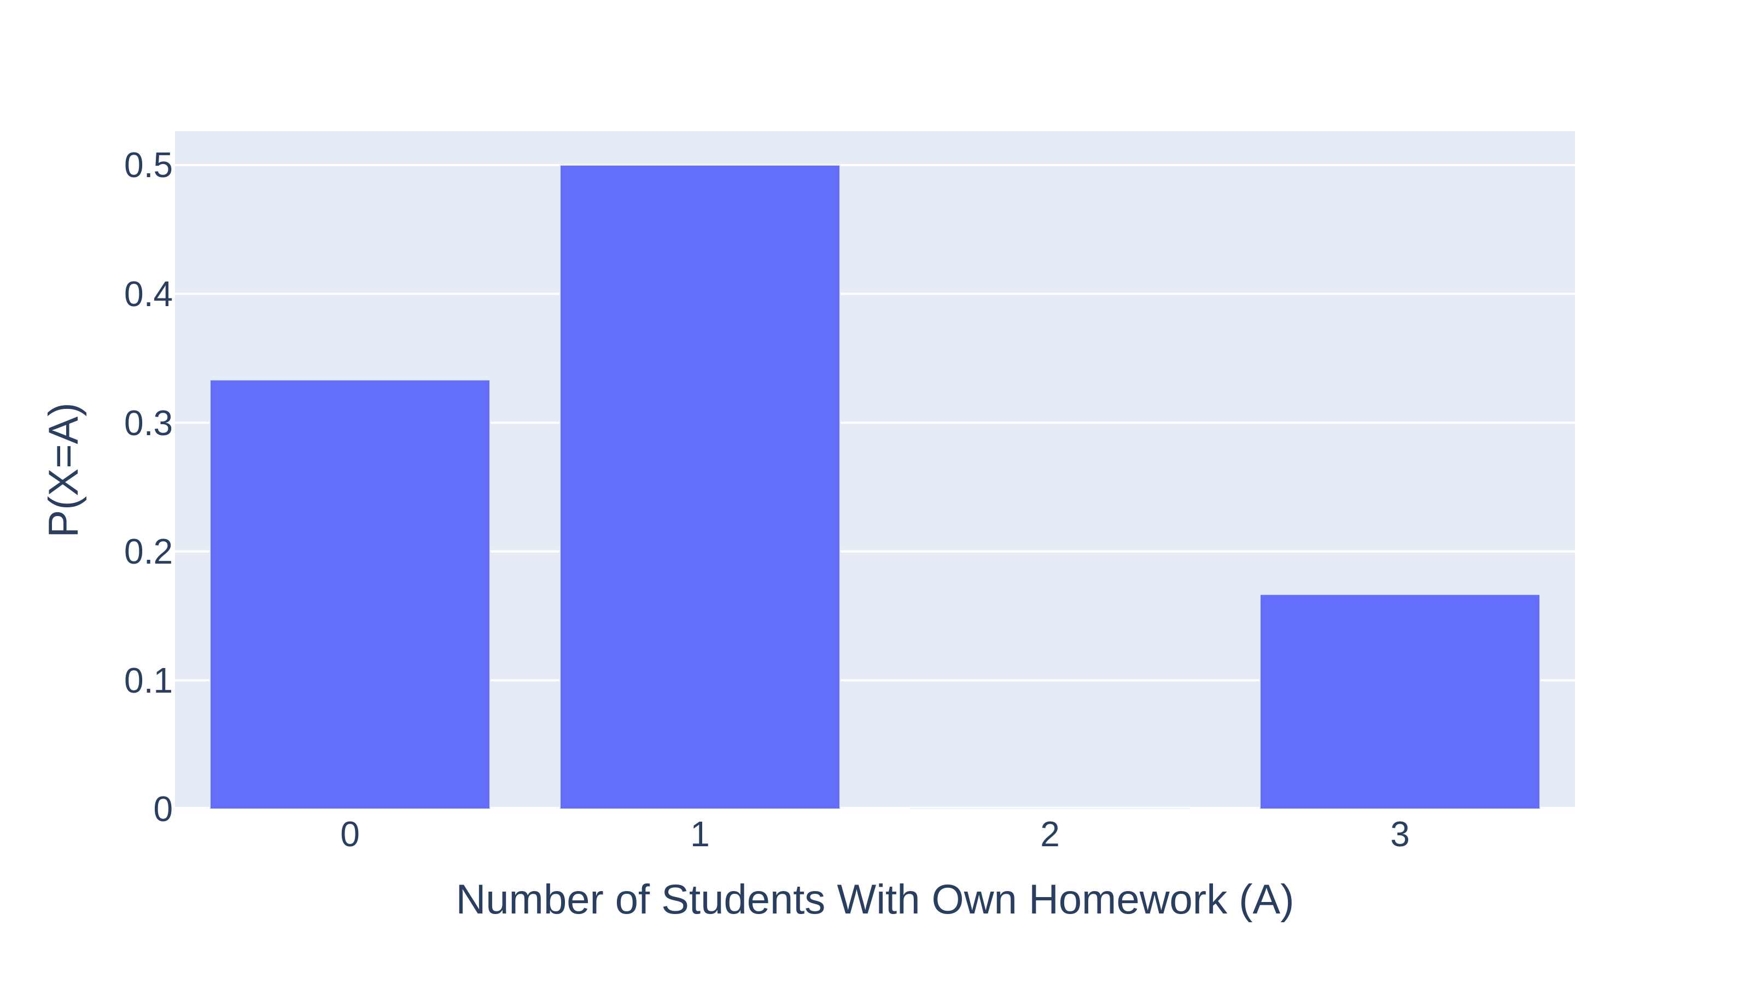
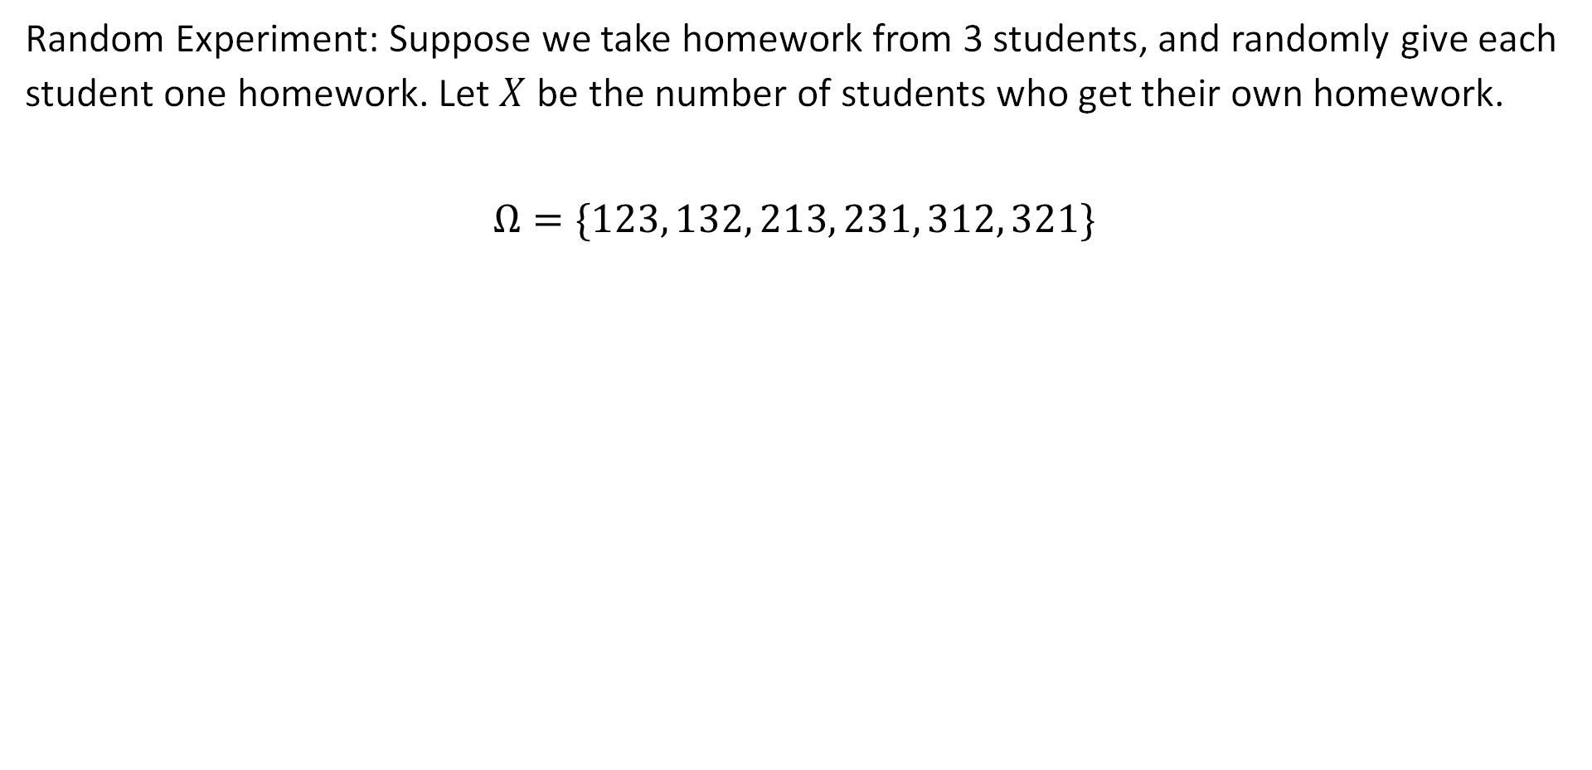
Distribution Example 3: Handing Back Assignments
Random Experiment: Suppose we take homework from 3 students, and randomly give each student one homework. Let $X$ be the number of students who get their own homework.
$$Ω=\{123, 132, 213, 231, 312, 321\}$$
X
3
1
1
0
0
1

Slide 31
The Expectation of a Random Variable
Definitions
Definition of a Random Variable
Distribution of a Random Variable
Expectation of a Random Variable
Example Distributions
Bernoulli
Binomial
Geometric
Poisson
Lecture 18, CS70 Fall 2025

Slide 32

Distributions and Expectation
Random Experiment: Pick a random student from CS70. $X$ is their grade on the first midterm.
What are some interesting questions we might ask about $X$?
What is the distribution of $X$?
What is the average of $X$? We’ll call this the expectation of X.
What is the standard deviation of $X$?

Slide 33

Expectation Informally
Let’s do a little experiment and flip 4 coins. Let $X$ be the number of heads. We’ll count:
How many times we get each value $a$ from $\{0, 1, 2, 3, 4\}$.
The average of the values we get.
https://joshh.ug/cs70/four_coin_flips_expectation_simulator.html

Slide 34


Simulation Results (My Experiment - Done Before Video)
Out of 20 flips, the average number of heads per flip was 1.7.
$$\frac{0+2+3+1+2+2+…+2}{20}=1.7$$
1, 2, and 3 were the most common value, occurring 25% of the time.

Slide 35


Simulation Results (My Experiment - Done Before Video)
Out of 150 flips, the average number of heads per flip was 1.99.
$$\frac{0+2+3+1+2+2+…+1}{150}=1.99$$
2 was the most common value, occurring 40% of the time.
Note: As the number of trials grows, the histogram looks increasingly like the distribution for the random variable $X$.

Slide 36

Simulation Results (My Experiment - Done Before Video)
Note: As the number of trials grows, the histogram looks increasingly like the distribution for the random variable $X$.
Question: If we know the exact distribution for $X$, how can we compute the average or expectation of $X$?
This is the average value that the simulation will eventually converge to (given enough samples).

Slide 37






Expectation (Formally)
The expectation of a random variable is defined as:
$$E\left[X\right]=\sum_{a∈range(X)}{a×P\left(X=a\right)}$$
Example: Flipping four coins.
$E\left[X\right]=0×1/16$
$$+4×1/16$$
$$+3×4/16$$
$$+2×6/16$$
$$+1×4/16$$
$$ω$$ | $$a$$ | $$P(X=a)$$
TTTT | 0 | $$1/16$$
HTTT, THTT, TTHT, TTTH | 1 | $$4/16$$
HHTT, HTHT, HTTH, THHT, THTH, TTHH | 2 | $$6/16$$
HHHT, HHTH, HTHH, THHH | 3 | $$4/16$$
HHHH | 4 | $$1/16$$

Slide 38





Expectation (Formally)
The expectation of a random variable is defined as:
$$E\left[X\right]=\sum_{a∈range(X)}{a×P\left(X=a\right)}$$
Example: Flipping four coins.
$E\left[X\right]=0$
$$+4/16$$
$$+12/16$$
$$+12/16$$
$$+4/16$$
$$ω$$ | $$a$$ | $$P(X=a)$$
TTTT | 0 | $$1/16$$
HTTT, THTT, TTHT, TTTH | 1 | $$4/16$$
HHTT, HTHT, HTTH, THHT, THTH, TTHH | 2 | $$6/16$$
HHHT, HHTH, HTHH, THHH | 3 | $$4/16$$
HHHH | 4 | $$1/16$$

Slide 39

Expectation (Formally)
The expectation of a random variable is defined as:
$$E\left[X\right]=\sum_{a∈range(X)}{a×P\left(X=a\right)}$$
Example: Flipping four coins.
$E\left[X\right]=32/16=2$
$$ω$$ | $$a$$ | $$P(X=a)$$
TTTT | 0 | $$1/16$$
HTTT, THTT, TTHT, TTTH | 1 | $$4/16$$
HHTT, HTHT, HTTH, THHT, THTH, TTHH | 2 | $$6/16$$
HHHT, HHTH, HTHH, THHH | 3 | $$4/16$$
HHHH | 4 | $$1/16$$

Slide 40

Expectation (Formally)
The expectation of a random variable is defined as:
$$E\left[X\right]=\sum_{a∈range(X)}{a×P\left(X=a\right)}$$
Observation: The expectation is just the dot product of the two “columns” of the distribution.
$E\left[X\right]=0×1/16+4×1/16+6×1/16+4×1/16+1×1/16$
$$ω$$ | $$a$$ | $$P(X=a)$$
TTTT | 0 | $$1/16$$
HTTT, THTT, TTHT, TTTH | 1 | $$4/16$$
HHTT, HTHT, HTTH, THHT, THTH, TTHH | 2 | $$6/16$$
HHHT, HHTH, HTHH, THHH | 3 | $$4/16$$
HHHH | 4 | $$1/16$$

Slide 41

Expectation (Formally)
Observation: The expectation is just the dot product of the two “columns” of the distribution.
$E\left[X\right]=0×1/16+4×1/16+6×1/16+4×1/16+1×1/16$
Question: Why does this make sense?
This is covered in this supplemental video (not during live lecture): https://youtu.be/KQfvsl0NgA8
$$ω$$ | $$a$$ | $$P(X=a)$$
TTTT | 0 | $$1/16$$
HTTT, THTT, TTHT, TTTH | 1 | $$4/16$$
HHTT, HTHT, HTTH, THHT, THTH, TTHH | 2 | $$6/16$$
HHHT, HHTH, HTHH, THHH | 3 | $$4/16$$
HHHH | 4 | $$1/16$$

Slide 42

Why Does the Experimental Average Converge to the Expectation?
The expectation is defined as:
$$E\left[X\right]=\sum_{a∈range(X)}{a×P\left(X=a\right)}$$
And given the outcome of $N$ random experiments, the experimental average is:
$$\frac{X_{1}+X_{2}+X_{3}+…+X_{N}}{N}$$
Above, $X_{1}$ is the result of the first experiment, $X_{2}$ the second experiment, etc.
Why does the experimental average converge to the expectation?

Slide 43

Why Does the Experimental Average Converge to the Expectation?
And given the outcome of $N$ random experiments, the experimental average is:
$$\frac{X_{1}+X_{2}+X_{3}+…+X_{N}}{N}$$
Thought experiment: If we do N experiments, roughly how many 0s will there be in the numerator? How many 1s? etc.

Slide 44

Why Does the Experimental Average Converge to the Expectation?
And given the outcome of $N$ random experiments, the experimental average is:
$$\frac{X_{1}+X_{2}+X_{3}+…+X_{N}}{N}$$
Thought experiment: If we do N experiments, roughly how many 0s will there be in the numerator? How many 1s? etc.
$N×P\left(X=0\right)$ 0s
$N×P\left(X=1\right)$ 1s
…
$N×P\left(X=4\right)$ 4s
(and so on if we have more values in the range of $X)$

Slide 45

Why Does the Experimental Average Converge to the Expectation?
And given the outcome of $N$ random experiments, the experimental average is:
$$\frac{X_{1}+X_{2}+X_{3}+…+X_{N}}{N}$$
Thought experiment: If we do N experiments, and there $N×P\left(X=0\right)$ 0s, $N×P\left(X=1\right)$ 1s, $N×P\left(X=2\right)$ 2s, …, and $N×P\left(X=4\right)$ 4s, what will be the numerator?

Slide 46


Why Does the Experimental Average Converge to the Expectation?
And given the outcome of $N$ random experiments, the experimental average is:
$$\frac{X_{1}+X_{2}+X_{3}+…+X_{N}}{N}$$
Thought experiment: If we do N experiments, and there $N×P\left(X=0\right)$ 0s, $N×P\left(X=1\right)$ 1s, $N×P\left(X=2\right)$ 2s, …, and $N×P\left(X=4\right)$ 4s, what will be the numerator?
$$\frac{X_{1}+X_{2}+X_{3}+…+X_{N}}{N}=$$
$$\frac{N×P\left(X=0\right)×0\text{+}N×P\left(X=1\right)×1+…+4×N×P\left(X=4\right)}{N}$$

Slide 47


Why Does the Experimental Average Converge to the Expectation?
And given the outcome of $N$ random experiments, the experimental average is:
$$\frac{X_{1}+X_{2}+X_{3}+…+X_{N}}{N}$$
Thought experiment: If we do N experiments, and there $N×P\left(X=0\right)$ 0s, $N×P\left(X=1\right)$ 1s, $N×P\left(X=2\right)$ 2s, …, and $N×P\left(X=4\right)$ 4s, what will be the numerator?
We cancel out the Ns, leaving us with exactly the formula for expectation:
$$\frac{X_{1}+X_{2}+X_{3}+…+X_{N}}{N}=$$
$$\frac{N×P\left(X=0\right)×0\text{+}N×P\left(X=1\right)×1+…+4×N×P\left(X=4\right)}{N}$$
$$P\left(X=0\right)×0\text{+}P\left(X=1\right)×1+…+4×P\left(X=4\right)=\sum_{a∈\{0, 1, 2, 3, 4\}}{a×P\left(X=a\right)}$$

Slide 48



Why Does the Experimental Average Converge to the Expectation?
And given the outcome of $N$ random experiments, the experimental average is:
$$\frac{X_{1}+X_{2}+X_{3}+…+X_{N}}{N}$$
Thought experiment: If we do N experiments, and there $N×P\left(X=0\right)$ 0s, $N×P\left(X=1\right)$ 1s, $N×P\left(X=2\right)$ 2s, …, what will be the numerator?
We cancel out the Ns, leaving us with exactly the formula for expectation:
$$\frac{X_{1}+X_{2}+X_{3}+…+X_{N}}{N}=$$
$$\frac{N×P\left(X=0\right)×0\text{+}N×P\left(X=1\right)×1+…}{N}$$
$$P\left(X=0\right)×0\text{+}P\left(X=1\right)×1+…=\sum_{a∈range(A)}{a×P\left(X=a\right)}$$

Slide 49




Alternate Equivalent Definition
The expectation is:
$$E\left[X\right]=\sum_{a∈range(X)}{a×P\left(X=a\right)}$$
We can also write this expression in terms of a sum over all outcomes $ω∈Ω$.
$$=\sum_{a∈range(X)}{\left(a×\sum_{ω:X\left(ω\right)=a}{P\left(ω\right)}\right)}$$
$$=\sum_{a∈range(X)}{\sum_{ω:X\left(ω\right)=a}{a×P(ω)}}$$
$$=\sum_{a∈range(X)}{\sum_{ω:X\left(ω\right)=a}{X\left(ω\right)×P(ω)}}$$

Slide 50
Bernoulli Random Variables
Definitions
Definition of a Random Variable
Distribution of a Random Variable
Expectation of a Random Variable
Example Distributions
Bernoulli
Binomial
Geometric
Poisson
Lecture 18, CS70 Fall 2025

Slide 51


Bernoulli Random Variable
A Bernoulli random variable has a distribution given by the equation below, where $0≤p≤1$.
Example: Suppose we flip a coin that comes up heads 75% of the time. Let $X$ be 1 if the coin comes up heads, and 0 if it comes up tails.
We’d say “$X$ is distributed as a Bernoulli random variable with $p=0.75$”
Or in writing we can say “$X\sim Bernoulli(0.75)$”.
This is just shorthand for saying “X is distributed as a Bernoulli random variable with $p=0.75$.
$$P\left(X=a\right)=\left\{\begin{aligned}p, if a=1 \\ 1−p, if a=0\end{aligned}\right.$$

Slide 52



Bernoulli Random Variables and Expectation
Suppose $X\sim Bernoulli(0.5)$. What is $E[X]$?
We have that $E\left[X\right]=0×P\left(X=0\right)+1×P\left(X=1\right)$.
$P\left(X=0\right)=1−p=0.5$
$P\left(X=1\right)=p=0.5$
So: $E\left[X\right]=0×0.5+1×0.5=0.5$
Note: The expected value of $X$ is a value that $X$ can never equal.
$$E\left[X\right]=\sum_{a∈range(X)}{a×P\left(X=a\right)}$$
$$P\left(X=a\right)=\left\{\begin{aligned}p, if a=1 \\ 1−p, if a=0\end{aligned}\right.$$

Slide 53

Bernoulli Random Variables and Expectation
Suppose $X\sim Bernoulli(p)$. What is $E[X]$?
We have that $E\left[X\right]=0×P\left(X=0\right)+1×P\left(X=1\right)$.
$P\left(X=0\right)=1−p$
$P\left(X=1\right)=p$
So: $E\left[X\right]=0×\left(1−p\right)+1×p=p$
That is, the expected value of a Bernoulli random variable is just the probability that it is 1 (i.e. that the “coin flip” comes up “heads”).
$$E\left[X\right]=\sum_{a∈range(X)}{a×P\left(X=a\right)}$$
$$P\left(X=a\right)=\left\{\begin{aligned}p, if a=1 \\ 1−p, if a=0\end{aligned}\right.$$

Slide 54

The Sum of Two Bernoulli Random Variables
Suppose $X_{1}\sim Bernoulli(p)$ and $X_{2}\sim Bernoulli\left(p\right)$. Suppose they are independent.
Let $Y=X_{1}+X_{2}$.
What is the distribution of $Y$?
What is $E\left[Y\right]$?

Slide 55


The Sum of Two Bernoulli Random Variables
Suppose $X_{1}\sim Bernoulli(p)$ and $X_{2}\sim Bernoulli\left(p\right)$. Suppose they are independent.
Let $Y=X_{1}+X_{2}$.
What is the distribution of $Y$?
To get $a=2$, both Bernoulli RVs must be 1.
To get $a=1$, one Bernoulli RV is 1, and the other is 0.
To get $a=0$, both Bernoulli RVs must be 0.
What is $E\left[Y\right]$?
$$P\left(X=a\right)=\left\{\begin{aligned}p^{2}, if a=2 \\ 2p(1−p), if a=1 \\ {\left(1−p\right)}^{2}, if a=0\end{aligned}\right.$$

Slide 56


The Sum of Two Bernoulli Random Variables
Suppose $X_{1}\sim Bernoulli(p)$ and $X_{2}\sim Bernoulli\left(p\right)$. Suppose they are independent.
Let $Y=X_{1}+X_{2}$.
What is the distribution of $Y$?
To get $a=2$, both Bernoulli RVs must be 1.
To get $a=1$, one Bernoulli RV is 1, and the other is 0.
To get $a=0$, both Bernoulli RVs must be 0.
What is $E\left[Y\right]$?
$$E\left[Y\right]=2×p^{2}+1×2p\left(1−p\right)+0×{\left(1−p\right)}^{2}$$
$$P\left(Y=a\right)=\left\{\begin{aligned}p^{2}, if a=2 \\ 2p(1−p), if a=1 \\ {\left(1−p\right)}^{2}, if a=0\end{aligned}\right.$$
$$=2p^{2}+2p−2p^{2}$$
$$=2p$$

Slide 57
Binomial Random Variables
Definitions
Definition of a Random Variable
Distribution of a Random Variable
Expectation of a Random Variable
Example Distributions
Bernoulli
Binomial
Geometric
Poisson
Lecture 18, CS70 Fall 2025

Slide 58

Binomial Distribution
The Binomial distribution models counting the number of heads if we flip $n$ coins that come up heads with probability $p$.
Let’s work out the distribution by considering a specific example. Suppose that $X\sim Binomial(n=5,p)$
$P\left(HHTHT\right)=p⋅p⋅\left(1−p\right)⋅p⋅\left(1−p\right)=p^{3}{\left(1−p\right)}^{2}$
$P\left(TTHHH\right)=\left(1−p\right)⋅\left(1−p\right)⋅p⋅p⋅p=p^{3}{\left(1−p\right)}^{2}$

Slide 59


Binomial Distribution
The Binomial distribution models counting the number of heads if we flip $n$ coins that come up heads with probability $p$.
Let’s work out the distribution by considering a specific example. Suppose that $X\sim Binomial(n=5,p)$
$P\left(HHTHT\right)=p⋅p⋅\left(1−p\right)⋅p⋅\left(1−p\right)=p^{3}{\left(1−p\right)}^{2}$
$P\left(TTHHH\right)=\left(1−p\right)⋅\left(1−p\right)⋅p⋅p⋅p=p^{3}{\left(1−p\right)}^{2}$
$P\left(X=3\right)= ???$
Joshh.ug/C

Slide 60


Binomial Distribution
The Binomial distribution models counting the number of heads if we flip $n$ coins that come up heads with probability $p$.
Let’s work out the distribution by considering a specific example. Suppose that $X\sim Binomial(n=5,p)$
$P\left(HHTHT\right)=p⋅p⋅\left(1−p\right)⋅p⋅\left(1−p\right)=p^{3}{\left(1−p\right)}^{2}$
$P\left(TTHHH\right)=\left(1−p\right)⋅\left(1−p\right)⋅p⋅p⋅p=p^{3}{\left(1−p\right)}^{2}$
$P\left(X=3\right)=\left(\# of sequences with 3 heads\right)p^{3}{\left(1−p\right)}^{2}$
$$=\left({5 \atop 3}\right)p^{3}{\left(1−p\right)}^{2}$$

Slide 61



Binomial Distribution
The Binomial distribution models counting the number of heads if we flip $n$ coins that come up heads with probability $p$.
Let’s work out the distribution by considering a specific example. Suppose that $X\sim Binomial(n=5,p)$
$P\left(X=i\right)=\left(\# of sequences with i heads\right)p^{i}{\left(1−p\right)}^{5−i}$
$$=\left({5 \atop i}\right)p^{i}{\left(1−p\right)}^{5−i}$$
for $i = 0, 1, 2, 3, 4, 5$

Slide 62



Binomial Distribution
The Binomial distribution models counting the number of heads if we flip $n$ coins that come up heads with probability $p$.
Let’s work out the distribution by considering a specific example. Suppose that $X\sim Binomial(n,p)$
$P\left(X=i\right)=\left(\# of sequences with i heads\right)p^{i}{\left(1−p\right)}^{n−i}$
$$=\left({n \atop i}\right)p^{i}{\left(1−p\right)}^{n−i}$$
for $i = 0, 1, 2, …,n$

Slide 63




Binomial Distribution
The Binomial distribution models counting the number of heads if we flip $n$ coins that come up heads with probability $p$.
$P\left(X=i\right)=\left(\# of sequences with i heads\right)p^{i}{\left(1−p\right)}^{n−i}$
$$=\left({n \atop i}\right)p^{i}{\left(1−p\right)}^{n−i}$$
for $i = 0, 1, 2, …,n$
$$Binomial(0.5, 100)$$

Slide 64


Binomial Distribution
The Binomial distribution models counting the number of heads if we flip $n$ coins that come up heads with probability $p$.
Suppose that $X\sim Binomial(n,p)$
$P\left(X=i\right)=\left({n \atop i}\right)p^{i}{\left(1−p\right)}^{n−i}$
Exercise: Verify that $\sum_{i=0}^{n}{\left({n \atop i}\right)p^{i}{\left(1−p\right)}^{n−i}}=1$.
We’ll cover the expectation of a Binomial RV next lecture.
You can do it using the usual sum, but that’s much messier than the nicer approach from the next lecture.
for $i = 0, 1, 2, …, n$

Slide 65





Binomial vs. Bernoulli Distribution
Note that a binomial random variable $X\sim Binomial(n,p)$ is simply the sum of $n$ independent random variables that are $Bernoulli\left(p\right)$.
We have not yet defined independent random variables.

Slide 66
Geometric Random Variables
Definitions
Definition of a Random Variable
Distribution of a Random Variable
Expectation of a Random Variable
Example Distributions
Bernoulli
Binomial
Geometric
Poisson
Lecture 18, CS70 Fall 2025

Slide 67

Geometric Distribution
Imagine a random experiment where we repeatedly flip a coin with a probability of heads equal to $p$ until we get heads. The flips are independent.
Let $X$ be the number of flips.
This distribution is called the geometric distribution, i.e. $X\sim Geometric\left(p\right)$
In the coin flipping example, what are the domain and range of $X$?
Domain: Any sequence of 0 or more tails, followed by a heads.
Range: Any integer greater than or equal to 1, i.e. $ℕ^{+}$
What is $P\left(X=1\right)$?
$p$

Slide 68

Geometric Distribution
Imagine a random experiment where we repeatedly flip a coin with a probability of heads equal to $p$ until we get heads. The flips are independent.
Let $X$ be the number of flips.
This distribution is called the geometric distribution, i.e. $X\sim Geometric\left(p\right)$
What is $P\left(X=i\right)$?
$P\left(X=2\right)=\left(1−p\right)⋅p$
$P\left(X=3\right)={\left(1−p\right)}^{2}⋅p$
$P\left(X=i\right)={\left(1−p\right)}^{i−1}⋅p$

Slide 69







Verifying that the Probabilities Sum to 1
Imagine a random experiment where we repeatedly flip a coin with a probability of heads equal to $p$ until we get heads. The flips are independent.
Let $X$ be the number of flips.
This distribution is called the geometric distribution, i.e. $X\sim Geometric\left(p\right)$
$P\left(X=i\right)={\left(1−p\right)}^{i−1}p$ for $i=1,2,…$
Let’s verify that the probabilities sum to 1.
$$\sum_{n=0}^{∞}{r^{n}=\frac{1}{1−r}}$$
$$\sum_{i=1}^{∞}{P\left(X=i\right)=}\sum_{i=1}^{∞}{{\left(1−p\right)}^{i−1}p}$$
$$=p\sum_{i=1}^{∞}{{\left(1−p\right)}^{i−1}}$$
$$=\frac{p}{p}$$
$$=\frac{p}{1−\left(1−p\right)}$$
$$=1$$

Slide 70
Geometric Random Variables and the Memoryless Property
Geometric random variables (and processes modeled by them) are memoryless:
It basically means: Even if you’ve waited a long time, the chance of the event occurring soon isn’t any better.
Example: You’re flipping a coin and it came up tails 10 times in a row. The chance of the next heads isn’t better just because you had 10 tails.
Example: You’ve lost all your money on your last 5 purchases of stock options. The chance of getting a good return are equally bad, and it doesn’t matter that you’ve made 5 bad trades in a row.

Slide 71

Geometric Random Variables and the Memoryless Property
Geometric random variables (and processes modeled by them) are memoryless:
It basically means: Even if you’ve waited a long time, the chance of the event occurring soon isn’t any better.
In terms of probability, we can state this as “If we’ve already tossed a coin $m$ times without getting a head, the probability that we need $n$ additional tosses is the same as if we hadn’t tossed the first $m$ coins at all.”
Or symbolically we have:
$$P\left(X>n+m | X>m\right)=P\left(X>n\right)$$

Slide 72



Geometric Random Variables and the Memoryless Property
Geometric random variables (and processes modeled by them) are memoryless:
It basically means: Even if you’ve waited a long time, the chance of the event occurring soon isn’t any better.
Proof of $P\left(X>n+m | X>m\right)=P\left(X>n\right)$
$$P\left(X>n+m | X>m\right)=\frac{P\left(X>n+m\right)}{P\left(X>m\right)}$$
$$=\frac{{\left(1−p\right)}^{n+m}}{{\left(1−p\right)}^{m}}$$
$$={\left(1−p\right)}^{n}$$
$$=P\left(X>n\right)$$

Slide 73

Without Proof: The Expectation of a Geometric Random Variable
Suppose we have a coin where the probability of heads is $p=0.2$. How many flips do you think we need to wait on average before we get our first heads?

Slide 74

Without Proof: The Expectation of a Geometric Random Variable
In the next lecture, we’ll prove this, but the expectation of a Geometric random variable is $E\left[X\right]=1/p$.
Example: If $p=0.2$, we wait for 5 flips on average before we get heads.

Slide 75




Expectation of a Geometric Random Variable
If $X\sim Geometric\left(p\right)$, what is $E\left[X\right]$? This is a fun one.
$P\left(X=i\right)={\left(1−p\right)}^{i−1}p$ for $i=1,2,…$
$$E\left[X\right]=p+2\left(1−p\right)p+3{\left(1−p\right)}^{2}p+…$$
First, multiply both sides by $\left(1−p\right)$
$$\left(1−p\right)E\left[X\right]=$$
$$(1−p)p+2{\left(1−p\right)}^{2}p+3{\left(1−p\right)}^{3}p+…$$
Then, subtract the bottom equation from the top:
$$E\left[X\right]−\left(1−p\right)E\left[X\right]$$
$$=p+2\left(1−p\right)p+3{\left(1−p\right)}^{2}p+…$$
$$−\left(1−p\right)p −2{\left(1−p\right)}^{2}p−…$$
This is just $\sum_{i=1}^{∞}{P(X=i)}$
$$pE\left[X\right]=p+\left(1−p\right)p+{\left(1−p\right)}^{2}p+…$$
$$pE\left[X\right]=1$$
$$E\left[X\right]=1/p$$

Slide 76

Expectation of a Geometric Random Variable
If $X\sim Geometric\left(p\right)$, what is $E\left[X\right]$? This is a fun one.
$P\left(X=i\right)={\left(1−p\right)}^{i−1}p$ for $i=1,2,…$
$E\left[X\right]=1/p$

Slide 77
Poisson Random Variables
Definitions
Definition of a Random Variable
Distribution of a Random Variable
Expectation of a Random Variable
Example Distributions
Bernoulli
Binomial
Geometric
Poisson
Lecture 18, CS70 Fall 2025

Slide 78


Poisson Distribution
Suppose we want to know how many alpha particles will be emitted by a radiation source. Let $X$ be the number of emissions per unit time.
Assumptions:
The average number of emissions is $λ$ alpha particles per unit time.
Emissions in disjoint time intervals are independent, e.g. if 2 particles were emitted in the interval [0, 2], this tells us absolutely nothing about how many were emitted in the interval [2.1, 4].
If assumptions hold, $X\sim Poisson(λ)$.
$$P\left(X=i\right)=\frac{λ^{i}}{i!}e^{−λ}, for i=0, 1, 2, …$$

Slide 79





Poisson Distribution Example
Suppose we want to know how many alpha particles will be emitted by a radiation source. Let $X$ be the number of emissions per unit time.
Suppose we model this radiation source as $X\sim Poisson(λ)$, where $λ=2$ emissions per minute.
What is the probability of seeing 3 emissions in any given minute?
$$P\left(X=i\right)=\frac{λ^{i}}{i!}e^{−λ}, for i=0, 1, 2, …$$
$$P\left(X=3\right)=\frac{2^{3}}{3!}e^{−2}$$
$$=\frac{8}{6}e^{−2}$$
$$=18.04\%$$

Slide 80

Useful Poisson Distribution Facts
The Poisson distribution comes from the large n limit for Binomial RVs.
That is, can think of $\frac{λ^{i}}{i!}e^{−λ}$ as arising from an infinite number of Bernoulli trials.
We’ll cover this in the next lecture. For today it’s just magic.
The expected value of a Poisson random variable is $λ$.
This is by definition! $λ$ was defined as the average number of events per unit time.
If we add independent $X\sim Poisson\left(λ\right)$ and $Y\sim Poisson\left(μ\right)$, and $Z=X+Y$, then $Z\sim Poisson(λ+μ)$.
We’re not equipped to prove this yet. This will come next lecture.

Slide 81



Poisson Distribution Example 2
Suppose we have two radiation sources. We model one as $X_{1}\sim Poisson(λ_{1})$, and the other as $X_{2}\sim Poisson(λ_{2})$.
If $λ_{1}=2$ emissions per minute, and $λ_{2}=5$ emissions per minute, what is the chance that the total number of emissions in a given minute is 4 emissions?
I claimed that the sum of two independent RVs is also Poisson. So $S=X_{1}+X_{2}$ is a random variable where $S\sim Poisson(7)$.
$$P\left(S=i\right)=\frac{λ^{i}}{i!}e^{−λ}, for i=0, 1, 2, …$$
$$P\left(S=4\right)=\frac{7^{4}}{4!}e^{−7}$$
$$=9.1\%$$

Slide 82

Poisson Distribution Example 3
Suppose we want to know how many alpha particles will be emitted by a radiation source. Let $X$ be the number of emissions per unit time.
Suppose we model this radiation source as $X\sim Poisson(λ)$, where $λ=2$ emissions per minute.
What is the probability that we get 100 emissions in an hour?

Slide 83



Poisson Distribution Example 3
Suppose we want to know how many alpha particles will be emitted by a radiation source. Let $X$ be the number of emissions per unit time.
Suppose we model this radiation source as $X\sim Poisson(λ)$, where $λ=2$ emissions per minute.
What is the probability that we get 100 emissions in an hour?
Need to convert our units. 2 emissions per minute is 120 emissions per hour.
Let $Y$ be $X$, but in units of emissions per hour. Then $Y\sim Poisson(120)$.
$$P\left(Y=i\right)=\frac{λ^{i}}{i!}e^{−λ}$$
$$P\left(Y=100\right)=\frac{{120}^{100}}{100!}e^{−120}$$
$$=0.68\%$$

Slide 84



Poisson Distribution Example 3 (Alternate Solution)
Suppose we want to know how many alpha particles will be emitted by a radiation source. Let $X$ be the number of emissions per unit time.
Suppose we model this radiation source as $X\sim Poisson(λ)$, where $λ=2$ emissions per minute.
What is the probability that we get 100 emissions in an hour?
The number of emissions per hour can be thought of as the sum of 60 independent RVs that are $\sim Poisson(λ)$.
Let $S$ be this sum. Then $S\sim Poisson(120)$.
$$P\left(S=i\right)=\frac{λ^{i}}{i!}e^{−λ}$$
$$P\left(S=100\right)=\frac{{120}^{100}}{100!}e^{−120}$$
$$=0.68\%$$

Slide 85
Summary
Lecture 18, CS70 Fall 2025

Slide 86

Summary
Today we introduced the concept of a random variable.
A function that maps outcomes to real numbers, e.g. $X(HHHH)=4$.
A random variable partitions a sample space. Each event in the partition is just the set of samples that yield a specific value.
The distribution of a random variable X is the set of all values in the range of X, along with the probability of those values.
The expectation of a random variable is the average value we expect to get if we average over a large number of random experiments with that RV.

Slide 87
Summary
We saw four important RVs:
Bernoulli: Biased coin flips.
Binomial: The sum of n biased coin flips.
Geometric: The number of times we flip a coin before we get the first heads.
Geometric RVs are memoryless.
Poisson: A model for the number of events when:
We know the average number of events per unit time.
Knowing the number of events in some time interval tells us absolutely nothing about the number of events in a disjoint time interval.
Poisson RVs sum nicely.
We’ll relate this type of RV back to Binomial RVs in the next lecture.

